Slide 1
Dental Disease Detection

Slide 2
PROJECT MODULES
Dataset labeling
Data preprocessing
Dental age detection
Dental Disease detection
GUI

Slide 3
DATASET
Panoramic Dental X-ray images
Total Images: 273
Type of X-ray: Extraoral

Slide 4
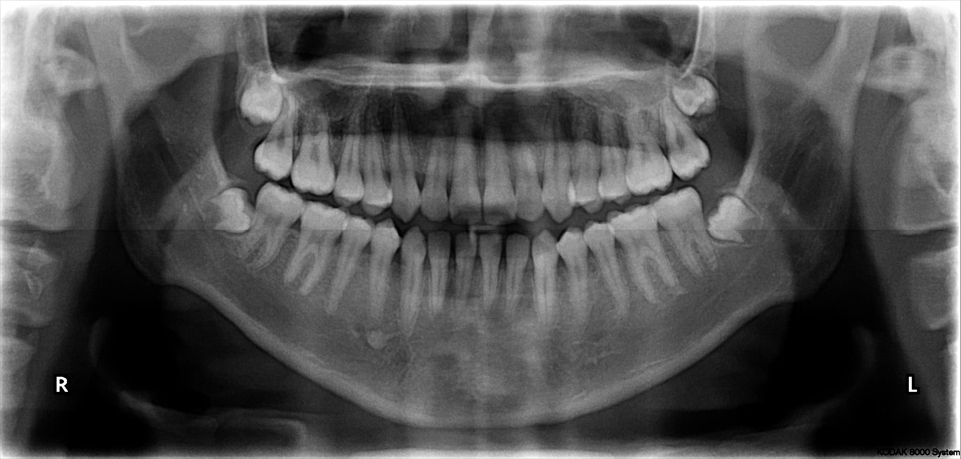
SAMPLE IMAGES
16 Years Male

Slide 5
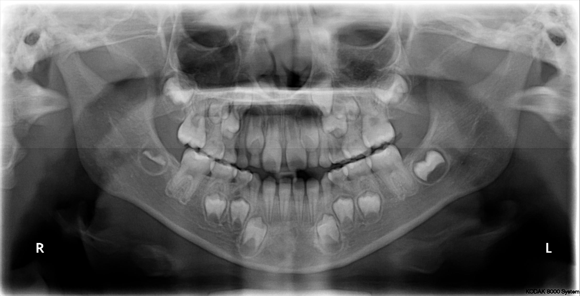
5 Years Male

Slide 6
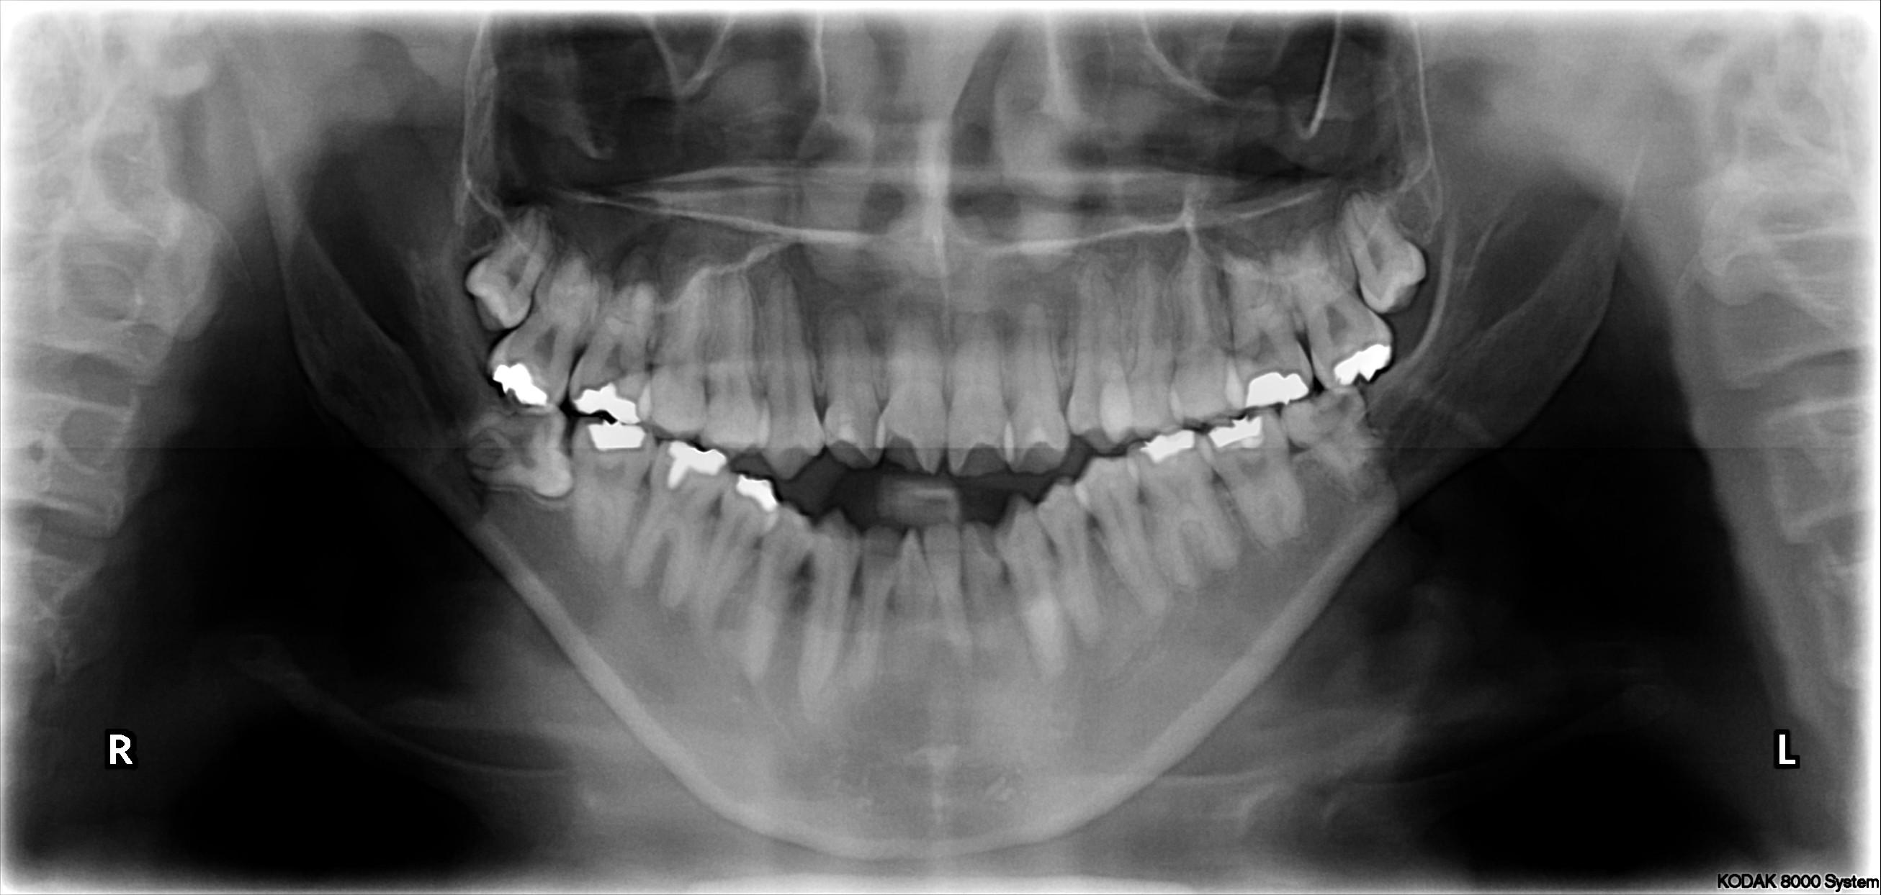
17 Years Male

Slide 7
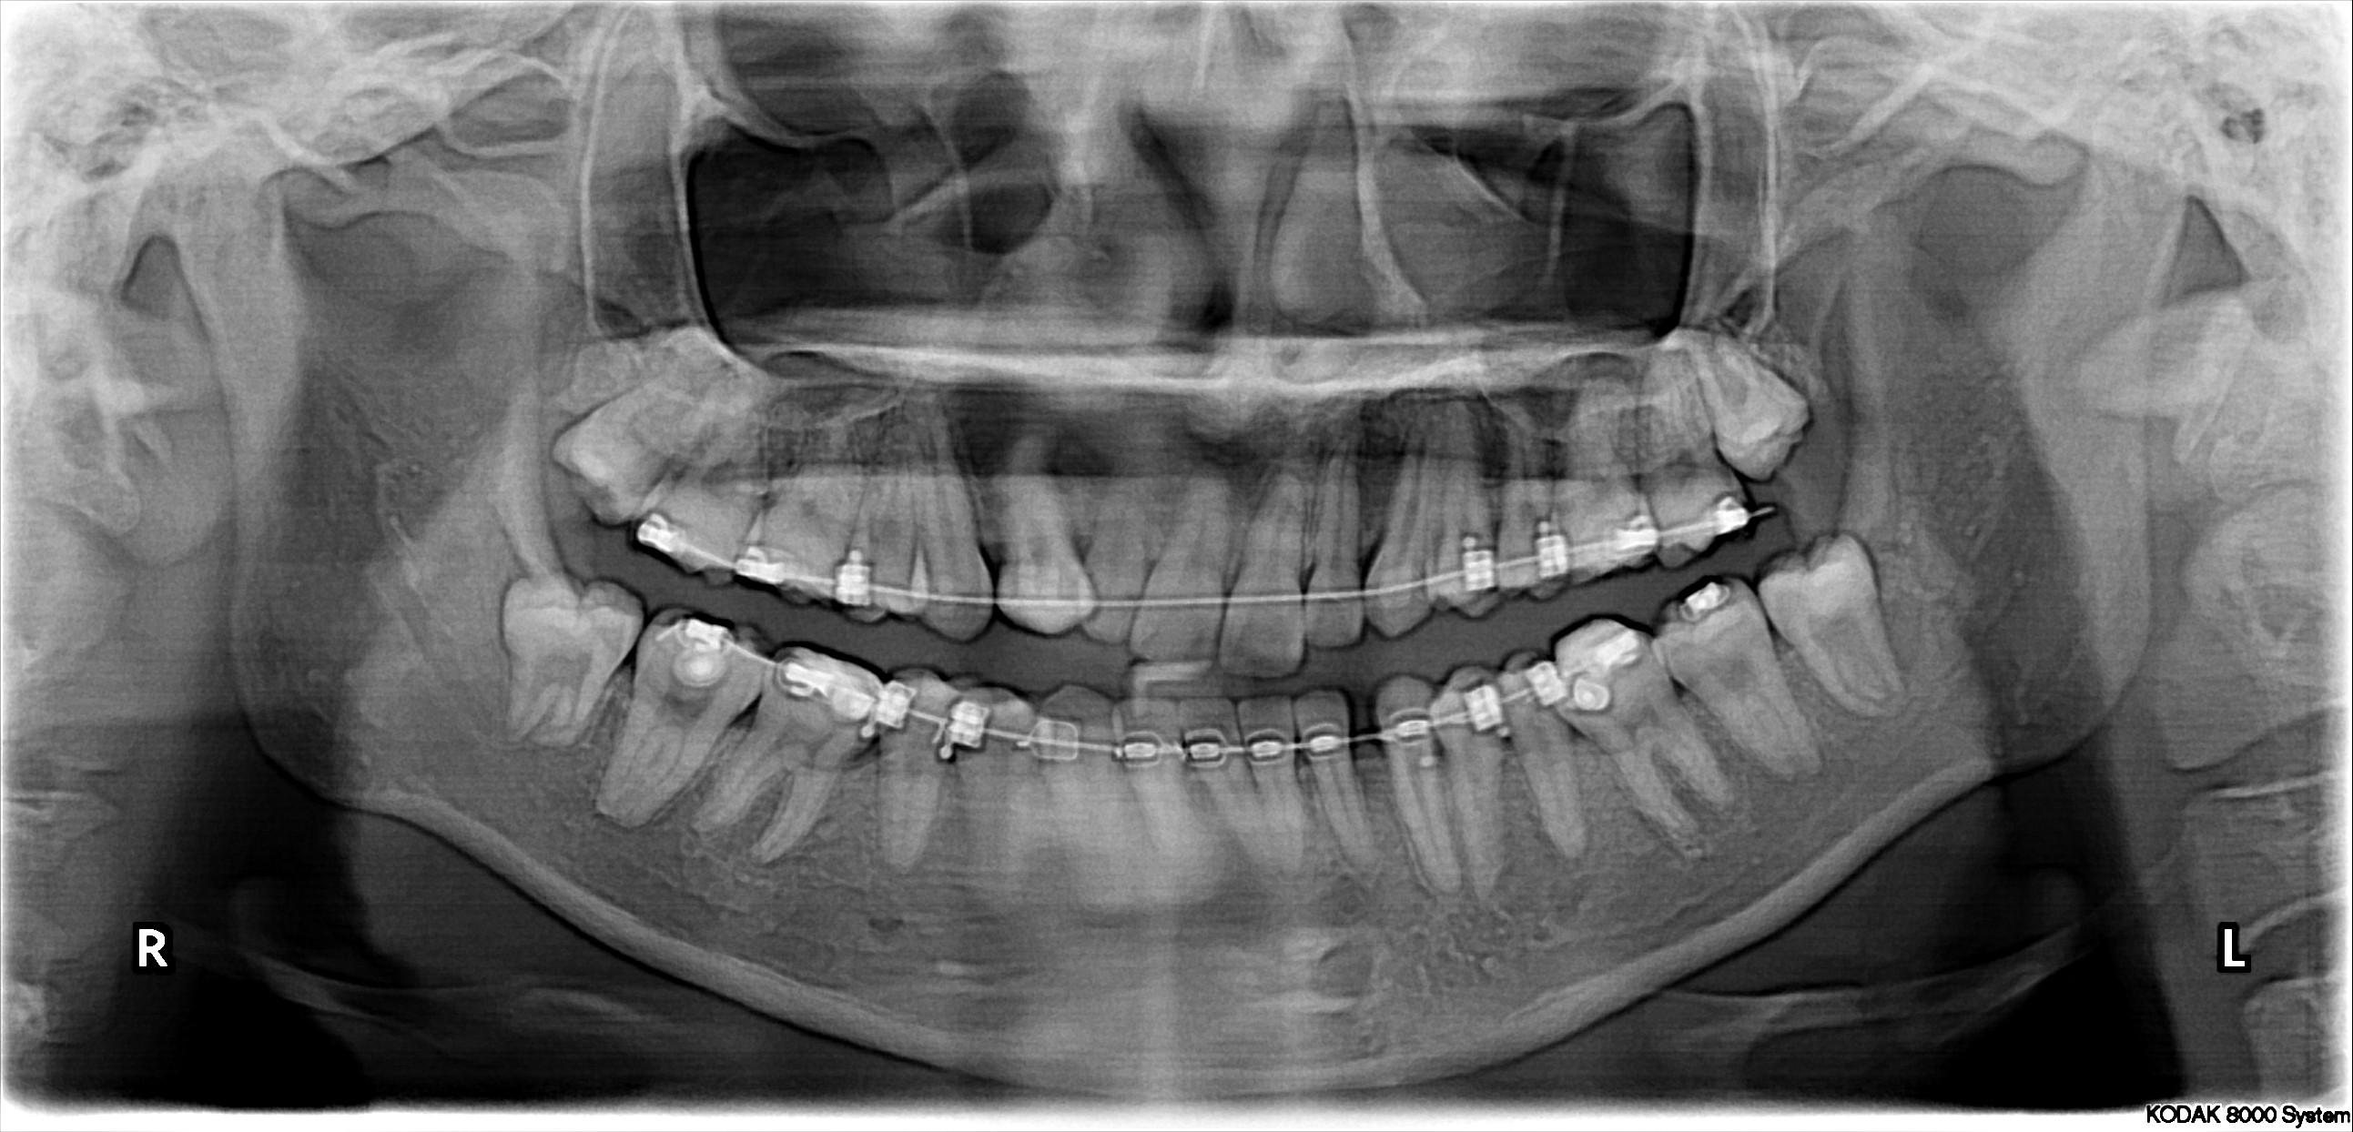
19 Years Female

Slide 8
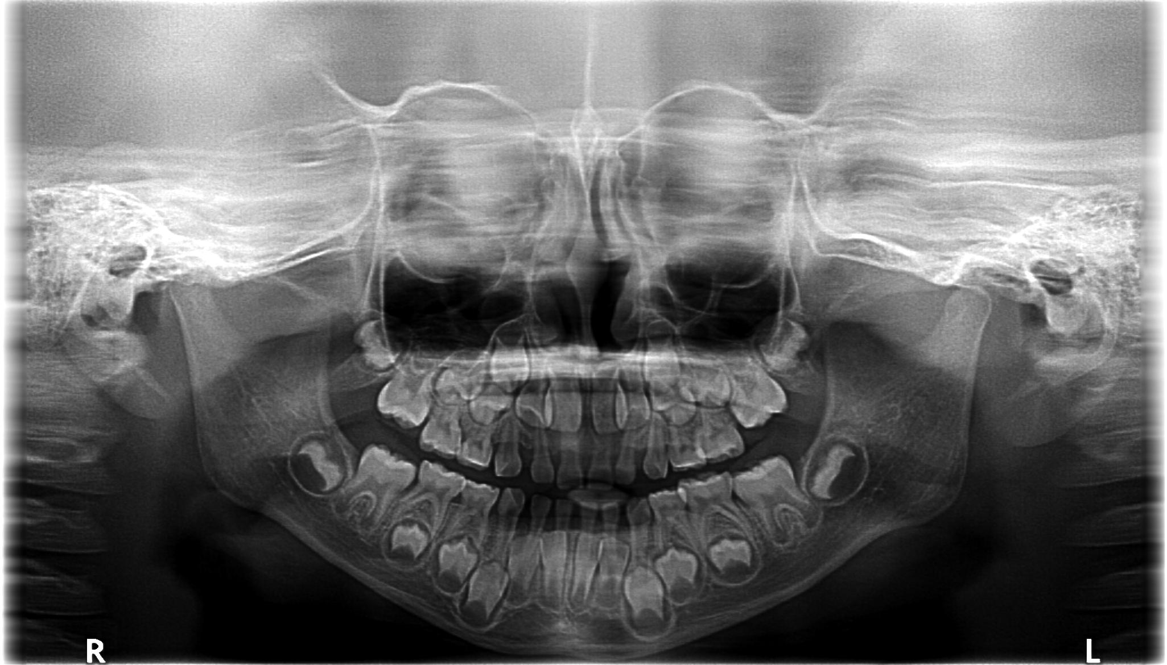
4 Years Female

Slide 9
PANORAMIC X-RAYS
Importance:
Other dental x-rays are intraoral, shows only a fragment of patient’s dentition
Panoramic x-rays shows full dentition, conveys largest amount of information
Problems:
Poor quality
Low contrast, uneven exposure
Severe skew
May contain excessive dental works(braces, tooth fillings) and occlusive teeth
No universal size or place of jaw in image
Automatic teeth segmentation is very tough

Slide 10
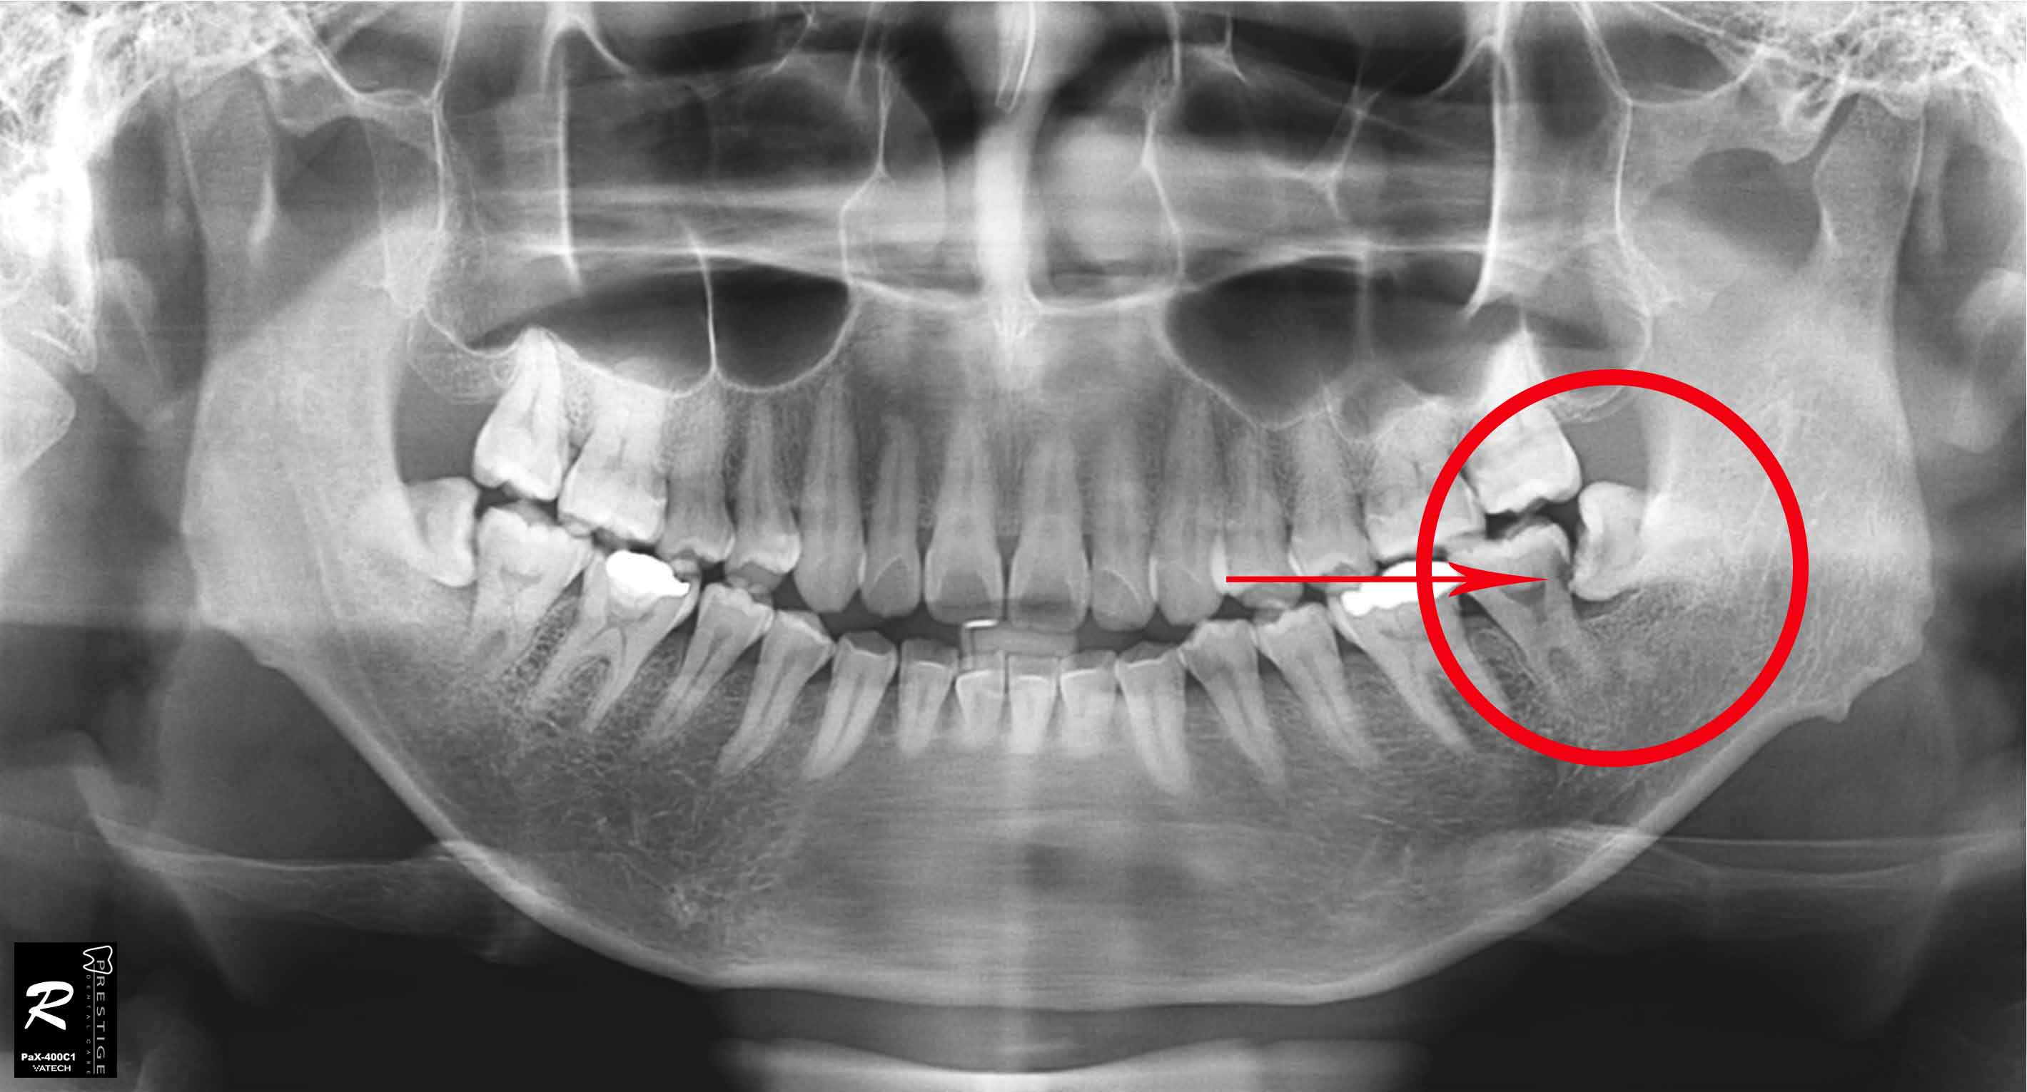
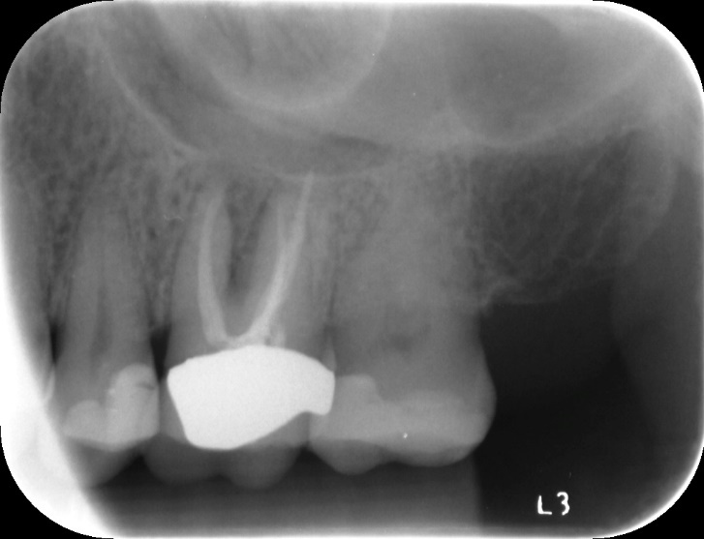
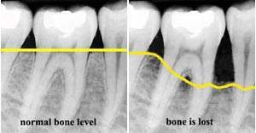
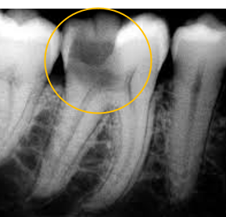
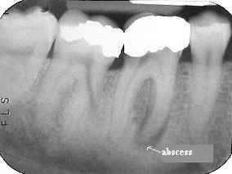
DENTAL DISEASES
Impacted Tooth
Rootpiece
Periodontal Disease
Dental Caries
Abscess

Slide 11
WORK FLOW
Input Image
Image Enhancement
Image Segmentation & ROI Extraction
Neural Network Classifier
Object Detection

Slide 12
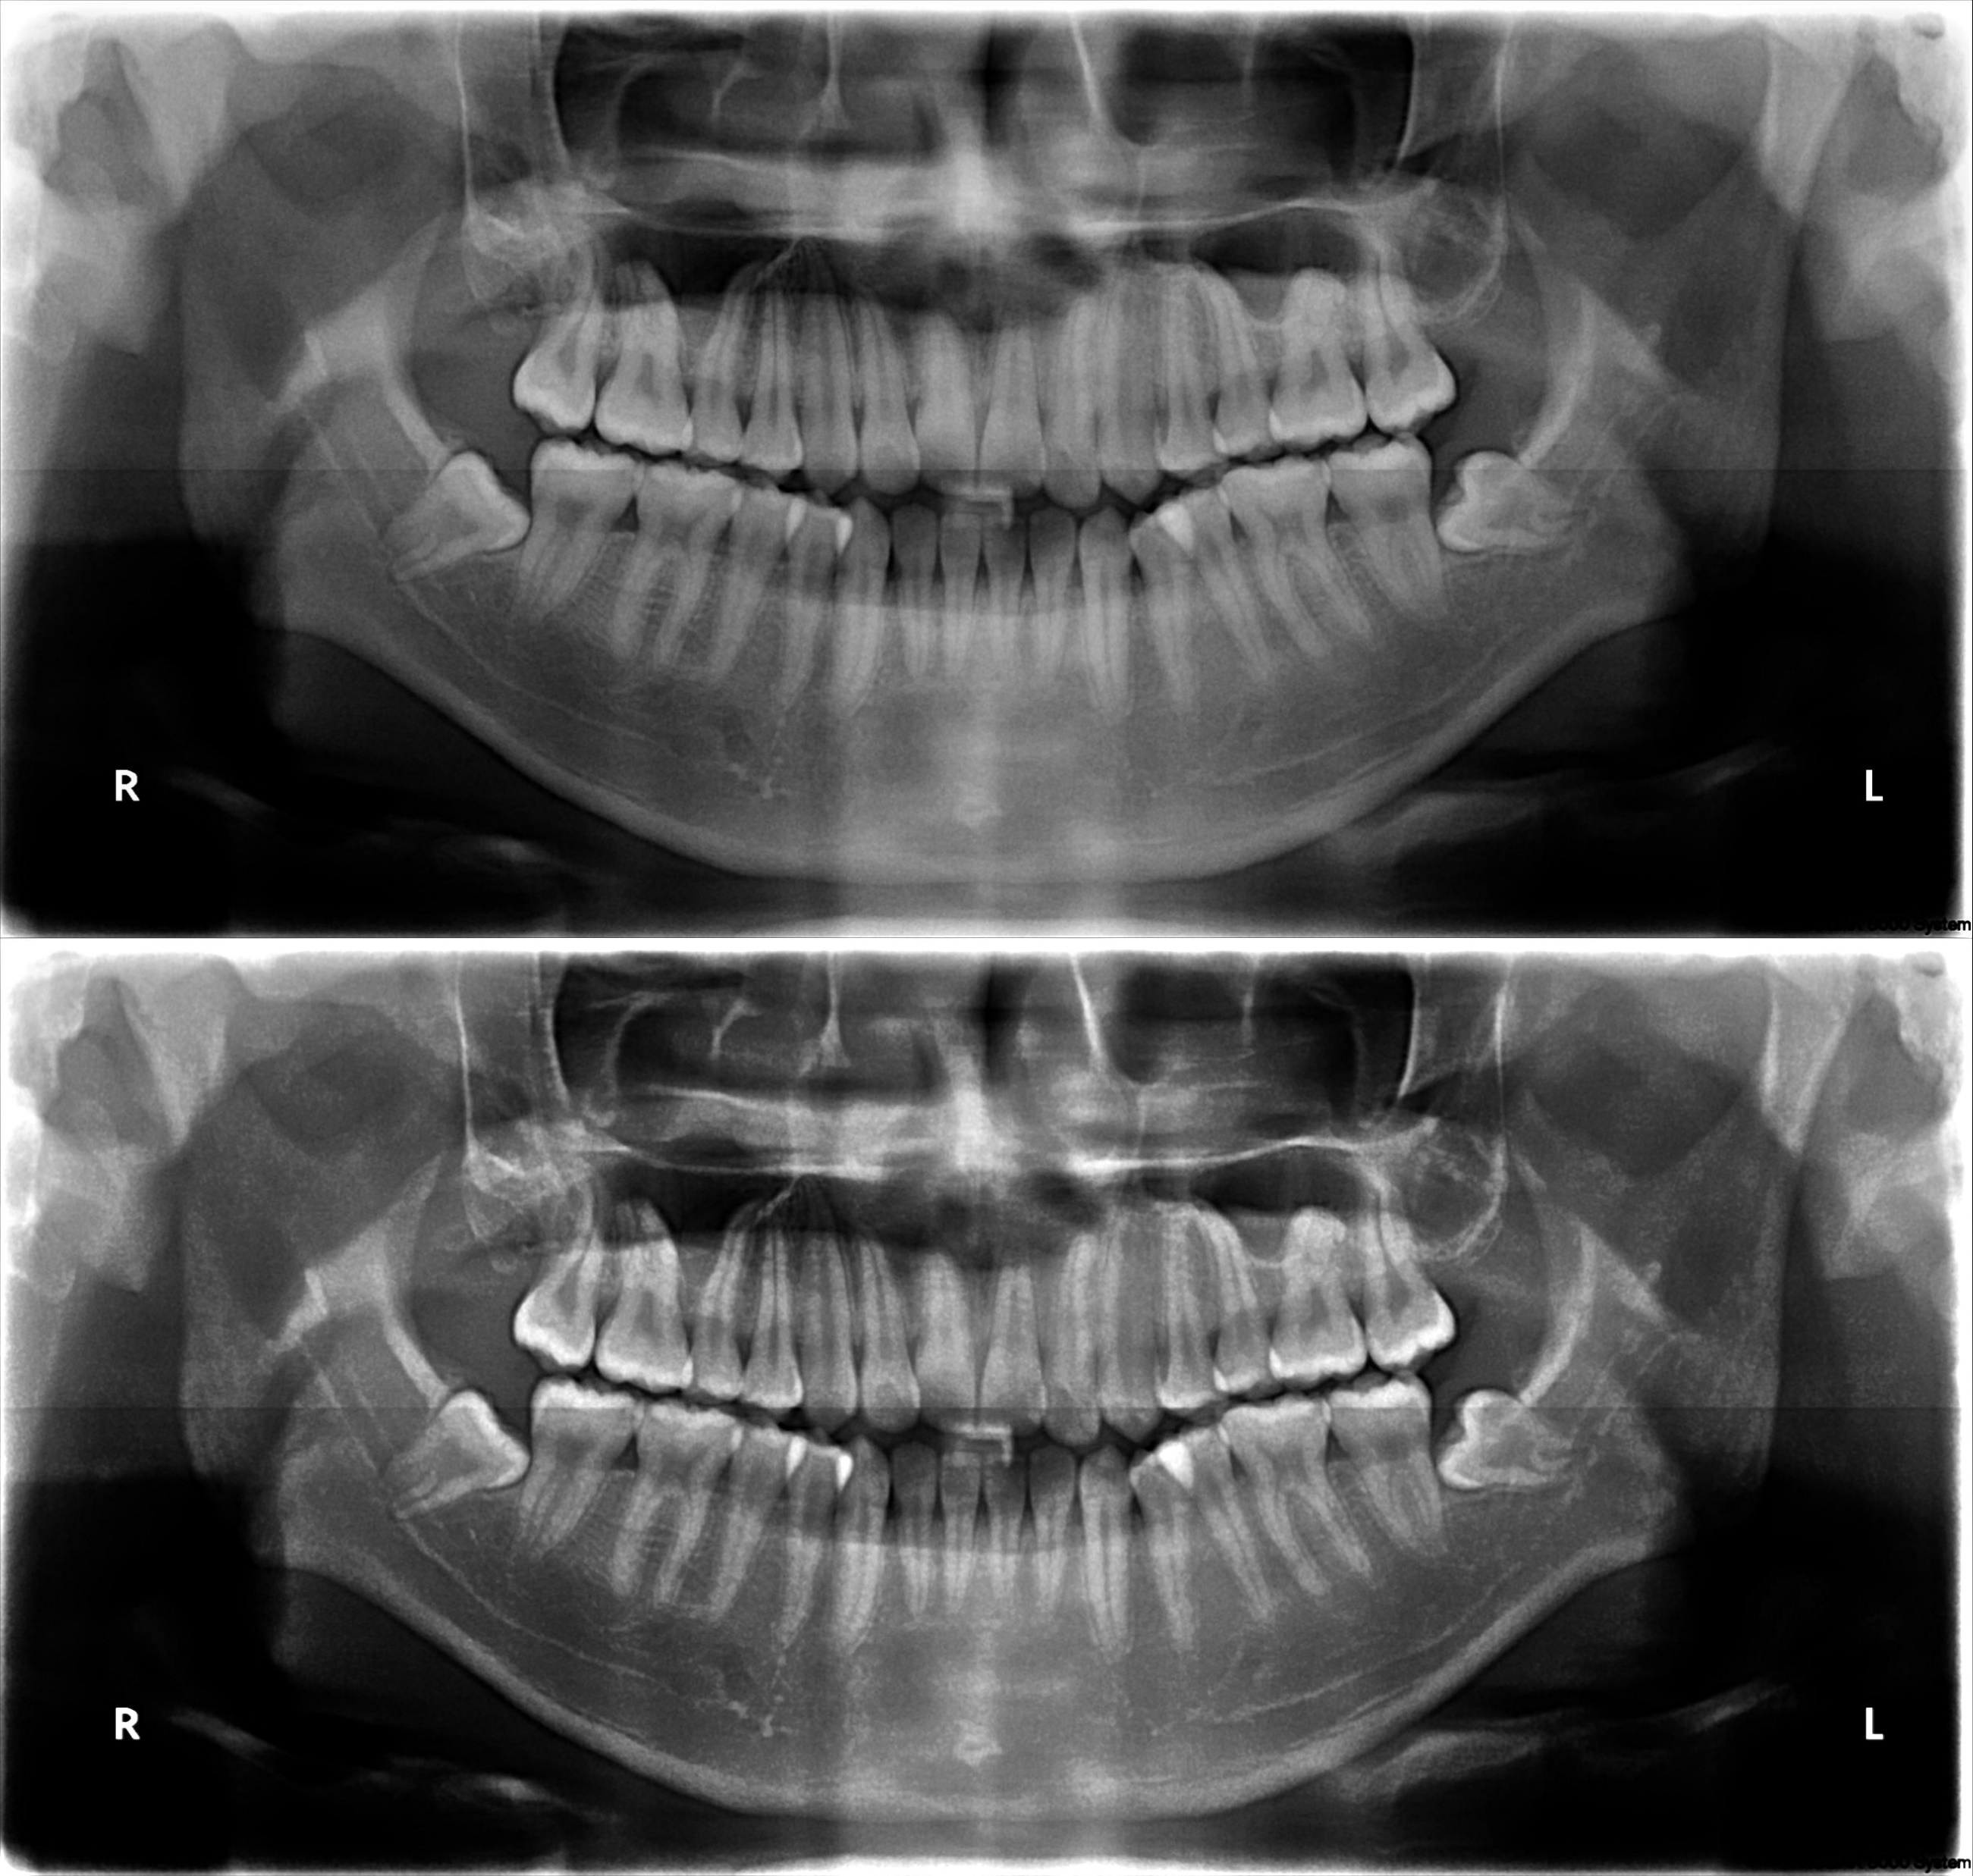
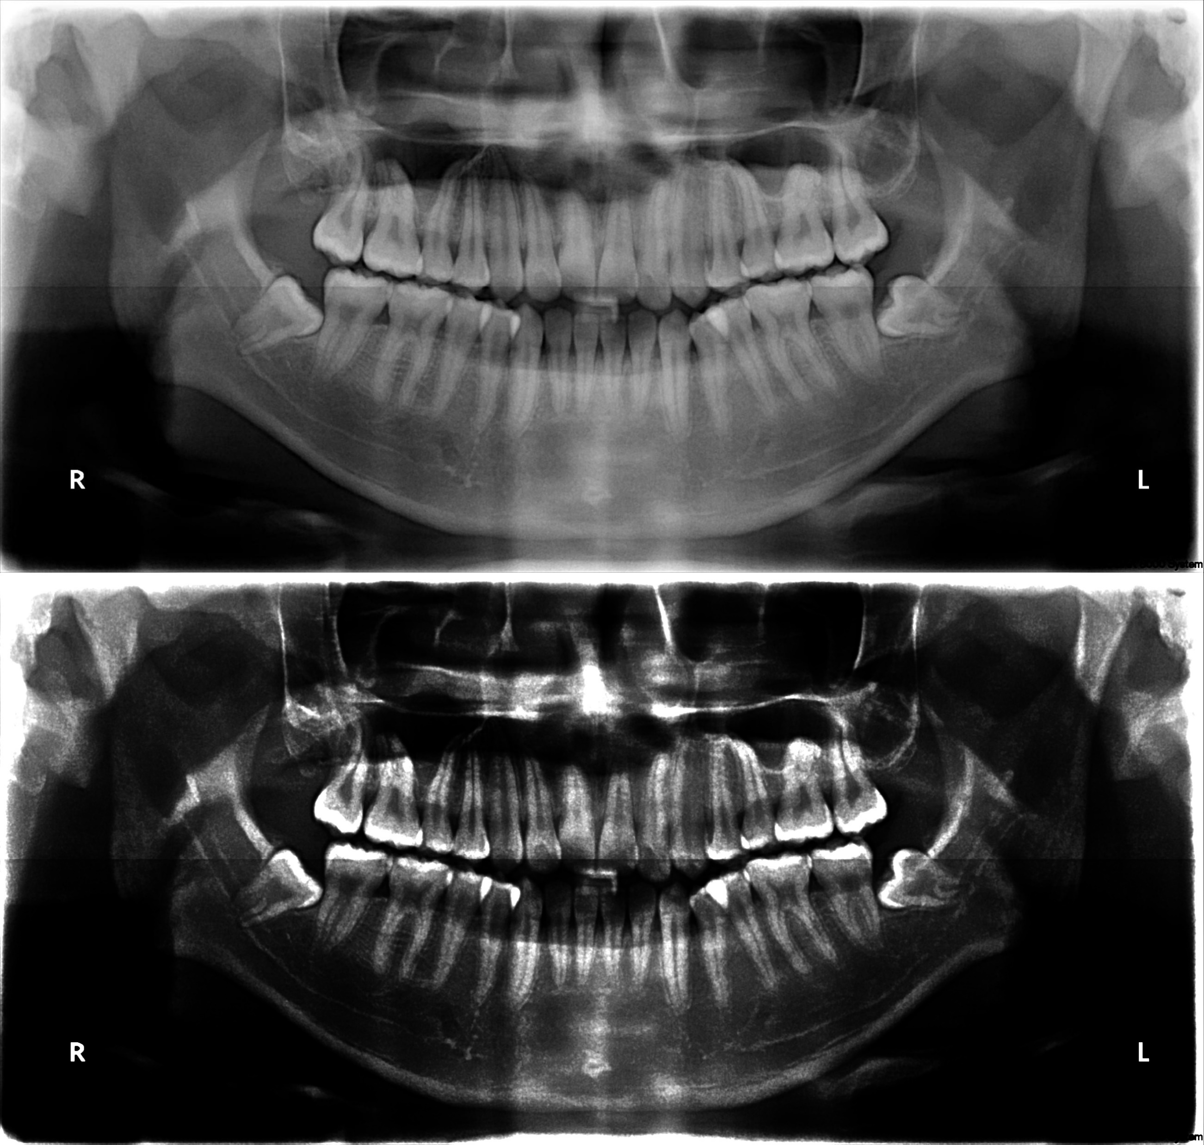
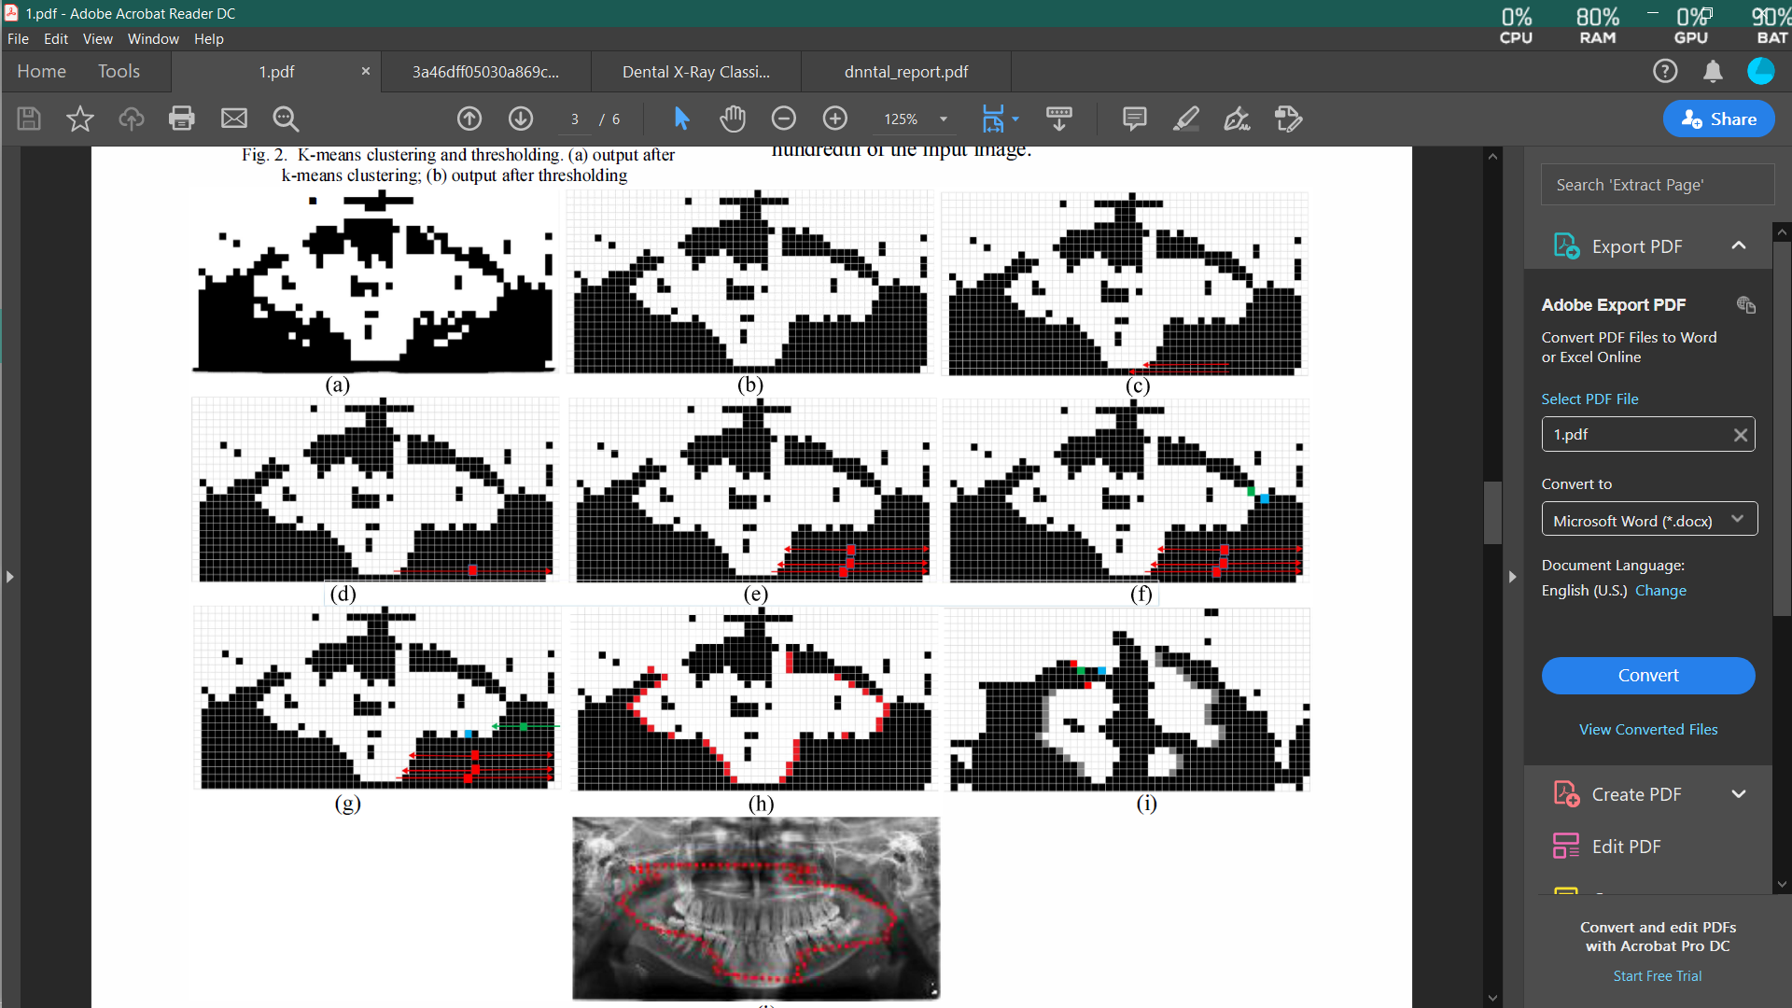
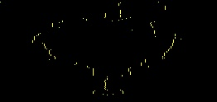
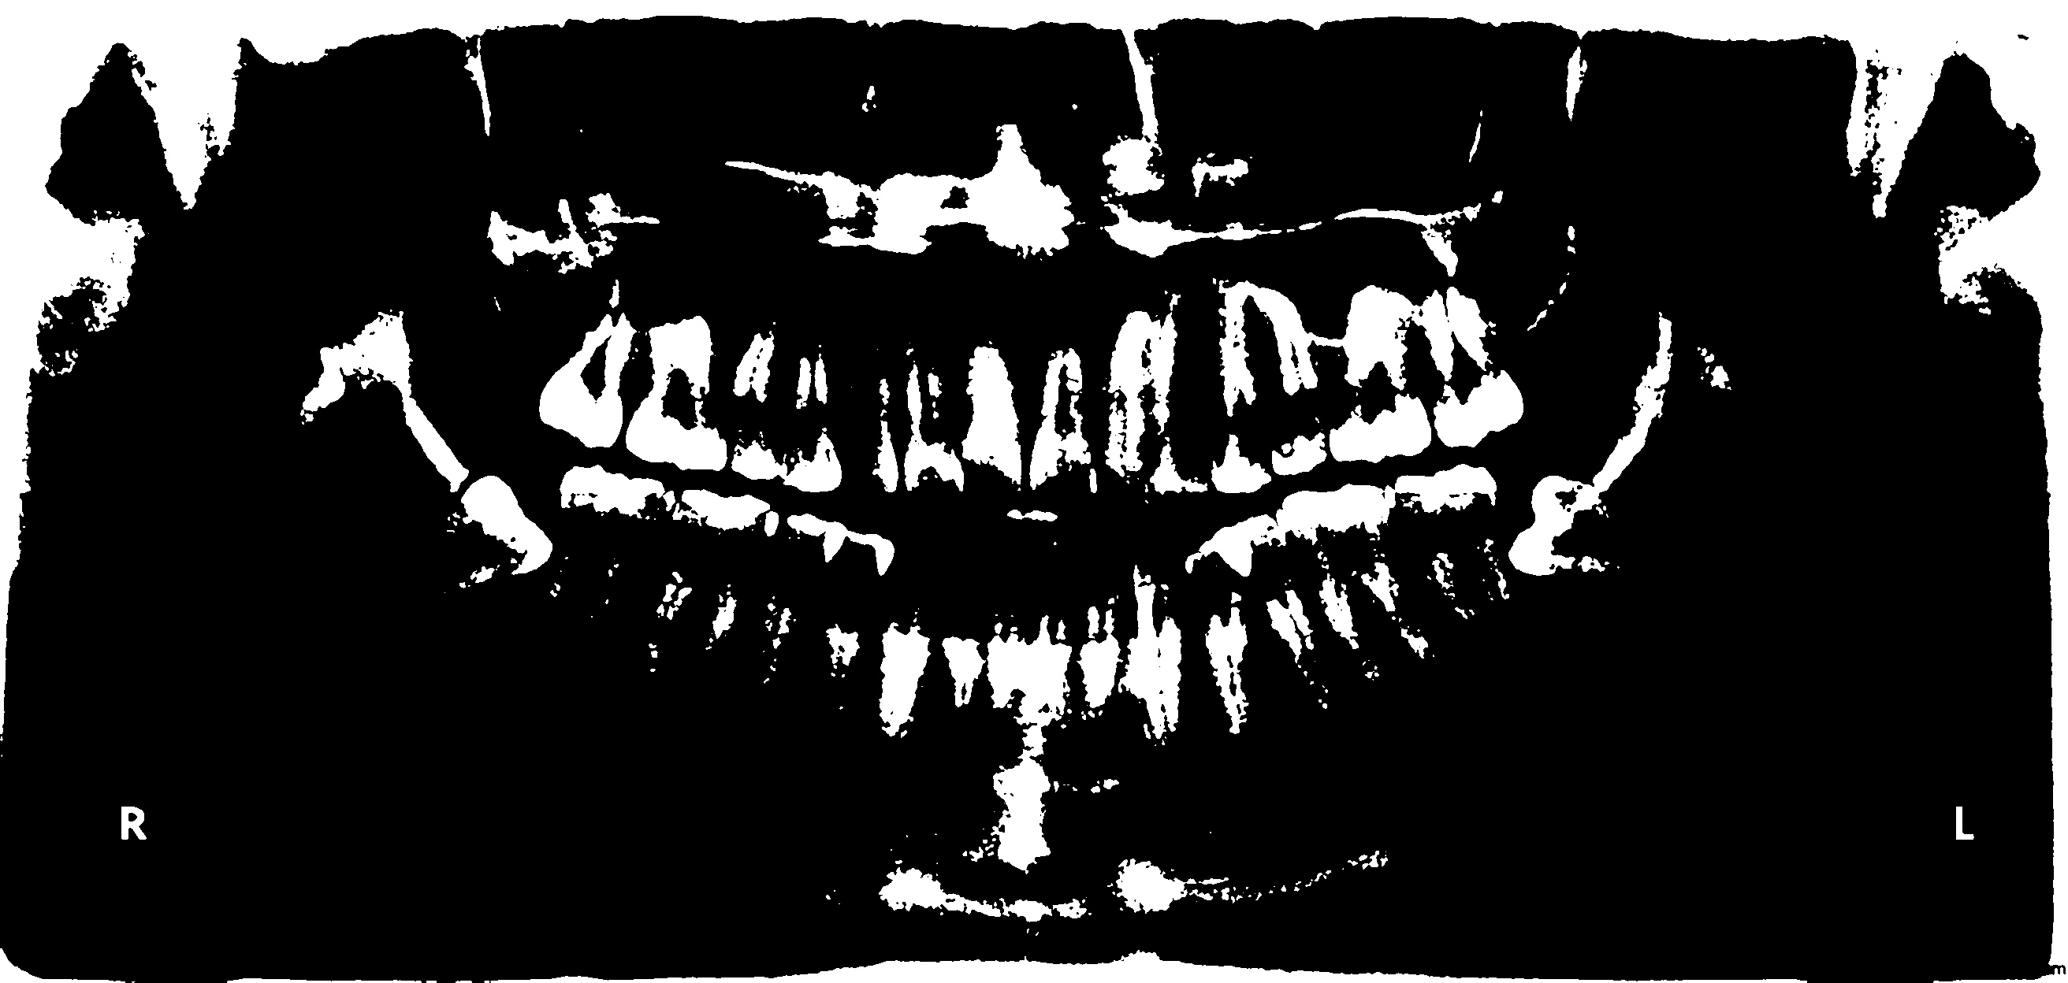
PROJECT OUTLINE
Input Image
Addition with 1st Laplacian Pyramid
Brightness & Contrast Correction
Points around Jaw
Finding points around jaw
Binary Thresholding

Slide 13
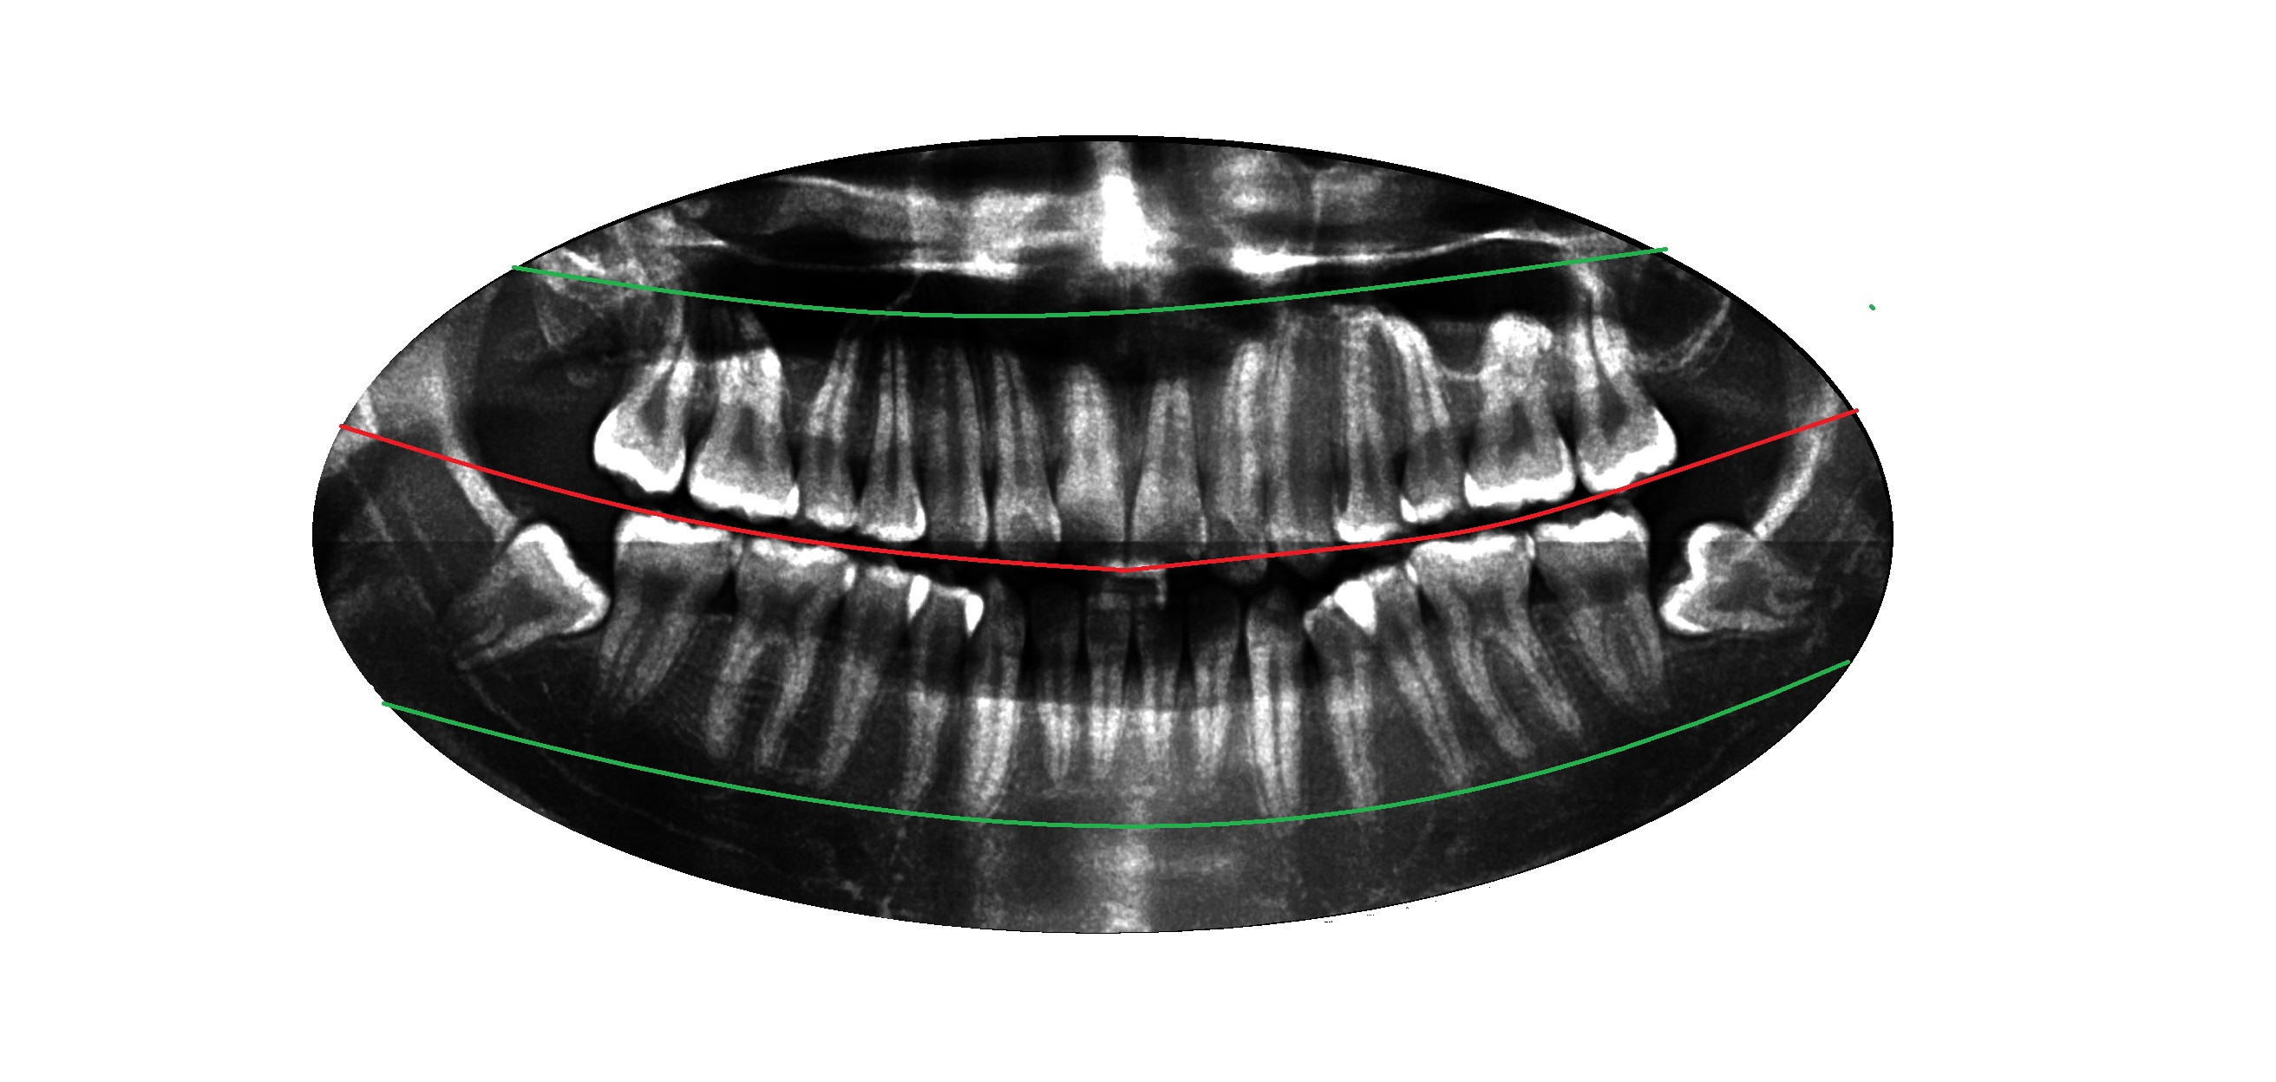
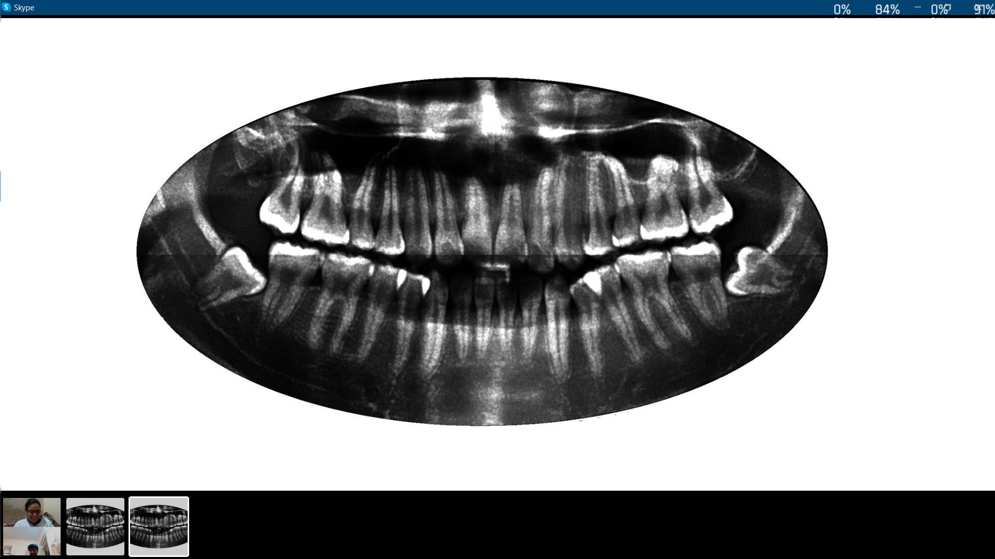
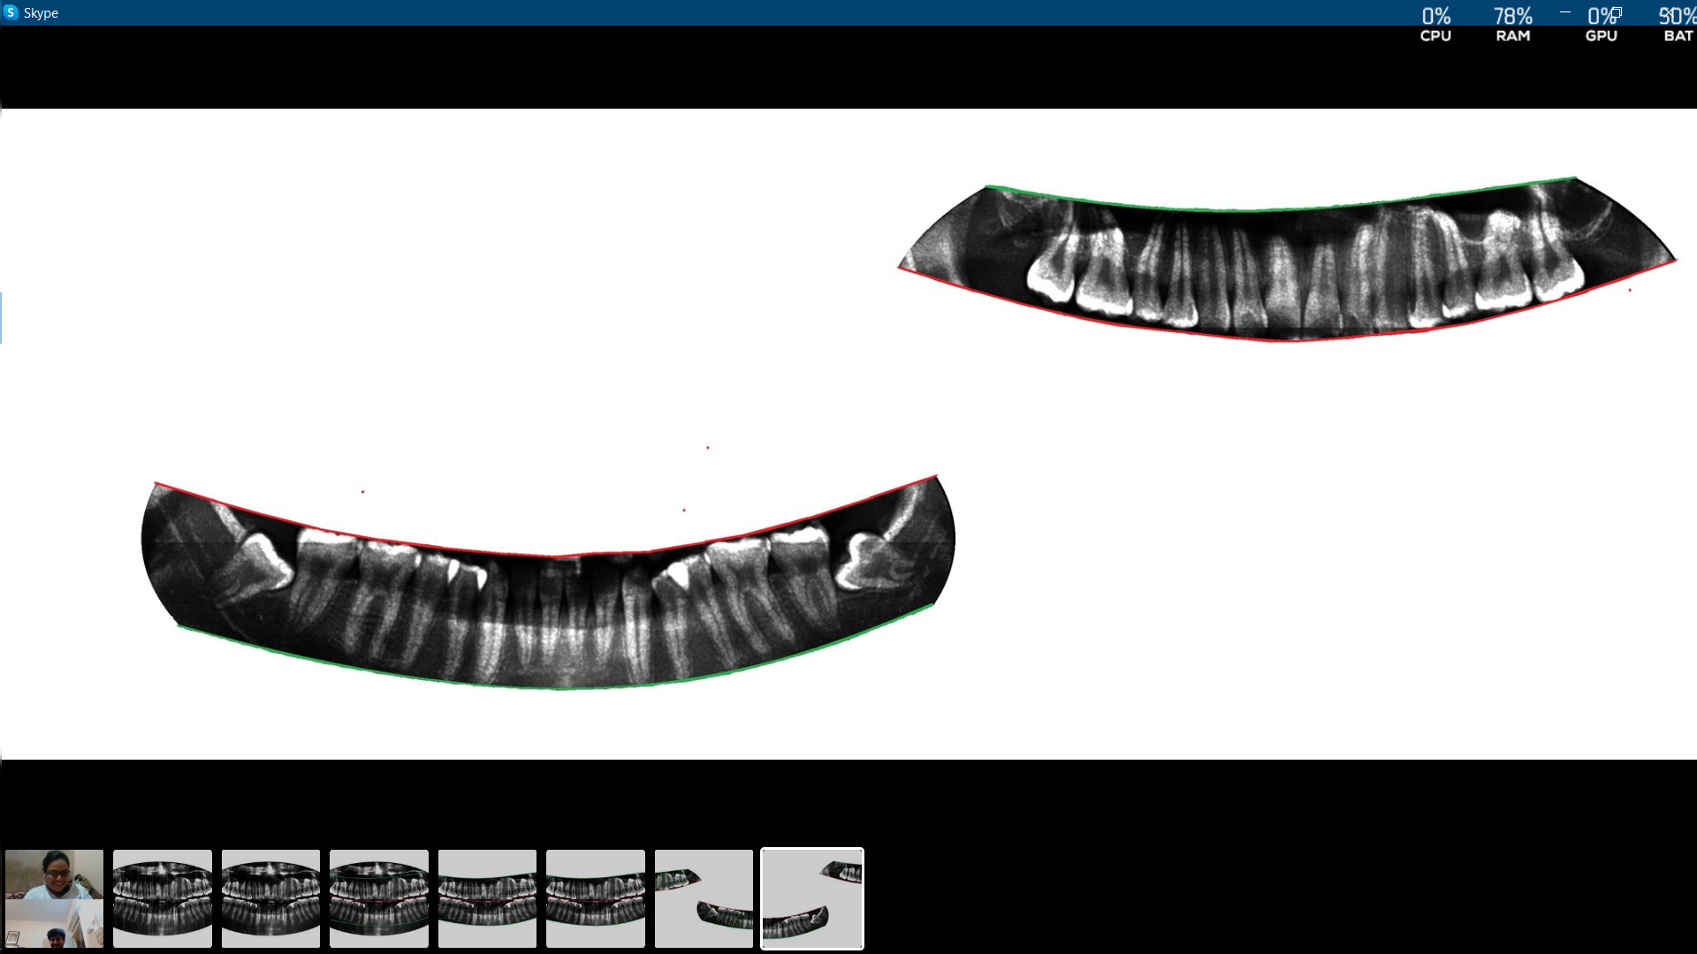
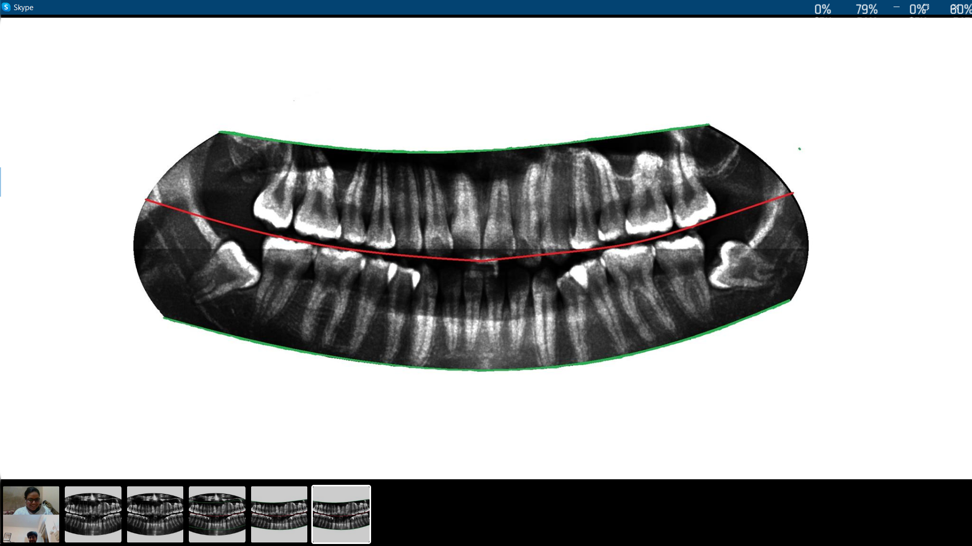
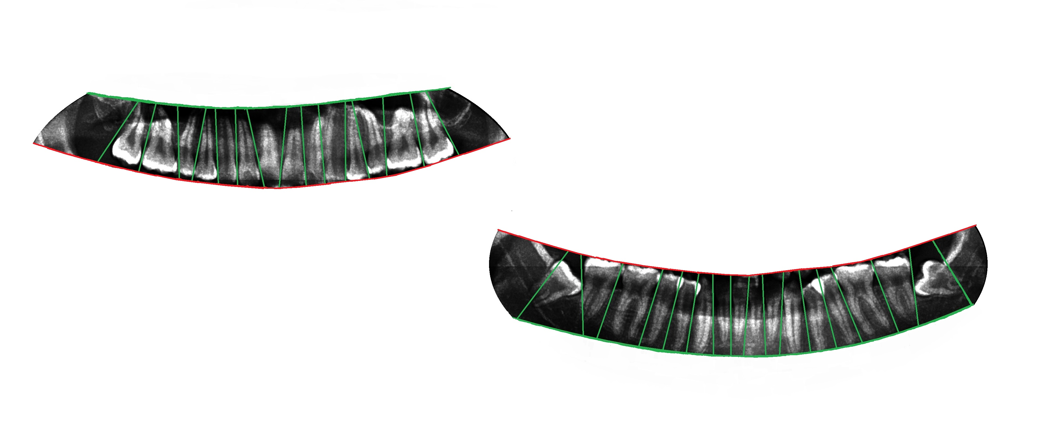
PROJECT OUTLINE
Points around Jaw
Ellipse Fitting
Jaw Separation
Upper Jaw
Teeth gap valley detection
Lower Jaw
Result

Slide 14
IMAGE ENHANCEMENT
Input image
Gaussian Pyramid
(5 layers)
Laplacian Pyramid
(4 layers)
Min-Max Normalization on 1st layer of Laplacian Pyramid
Addition with original image
Contrast Correction
(alpha,beta)
Brightness correction
(Gamma)

Slide 15
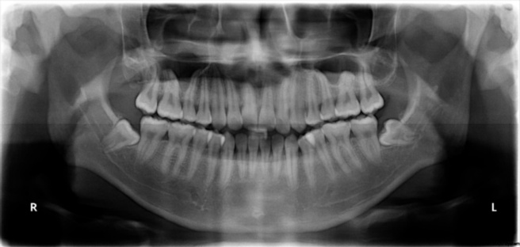
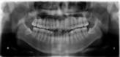
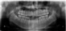


GAUSSIAN PYRAMID

Slide 16

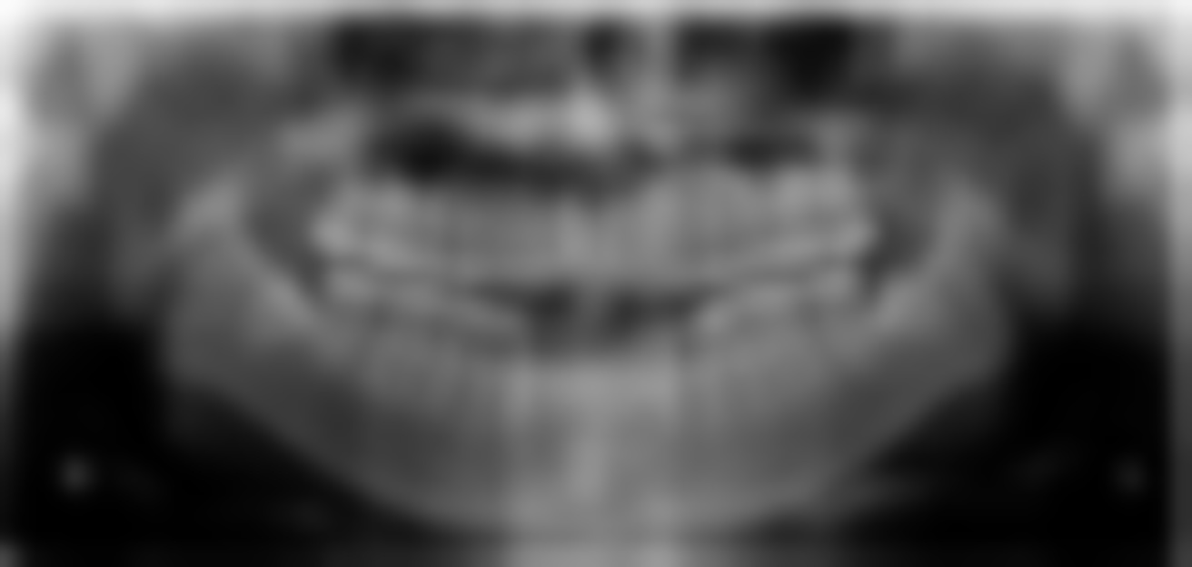


GAUSSIAN PYRAMID RECONSTRUCTION

Slide 17
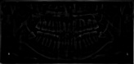
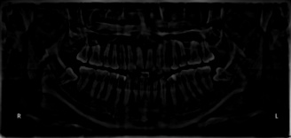
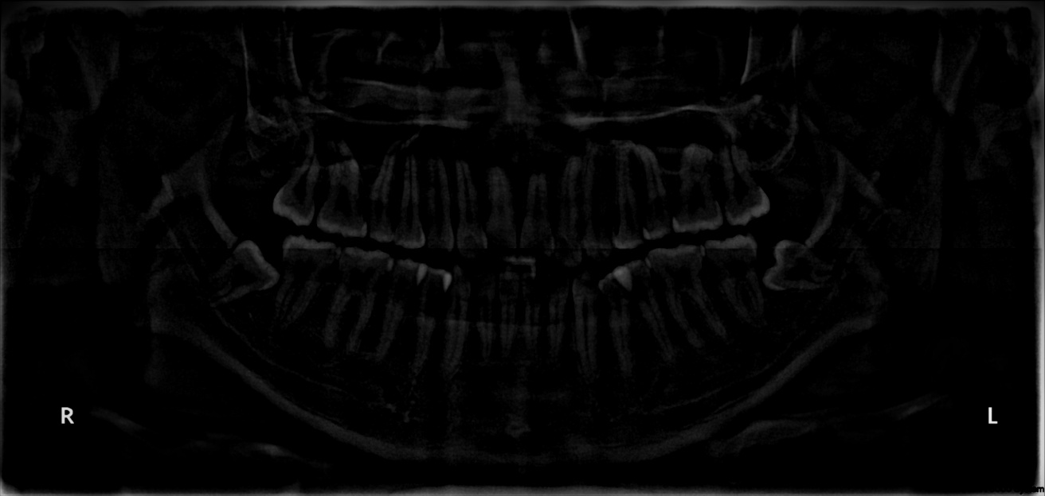

LAPLACIAN PYRAMID

Slide 18
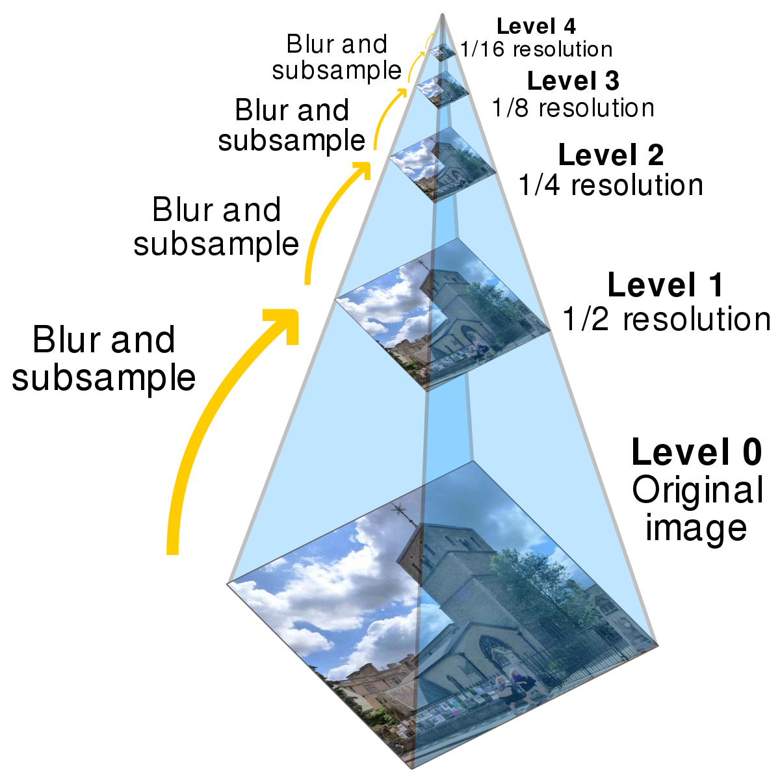
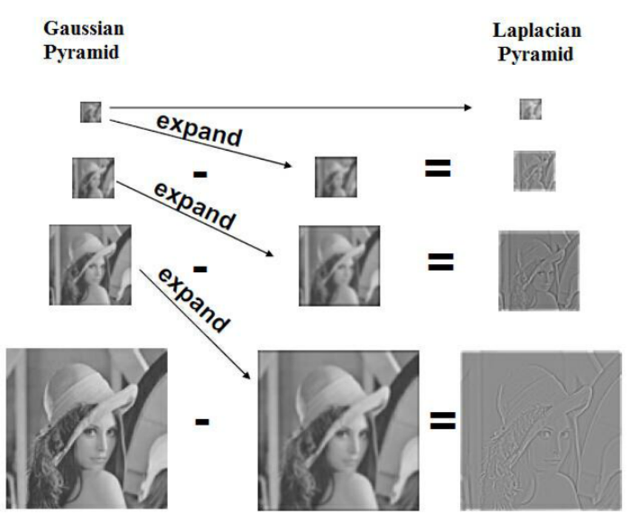
Gaussian Pyramid

Slide 19
Original Image
After addition with 1st Laplacian pyramid layer

Slide 20
Original Image
After Contrast
& Brightness Correction

Slide 21
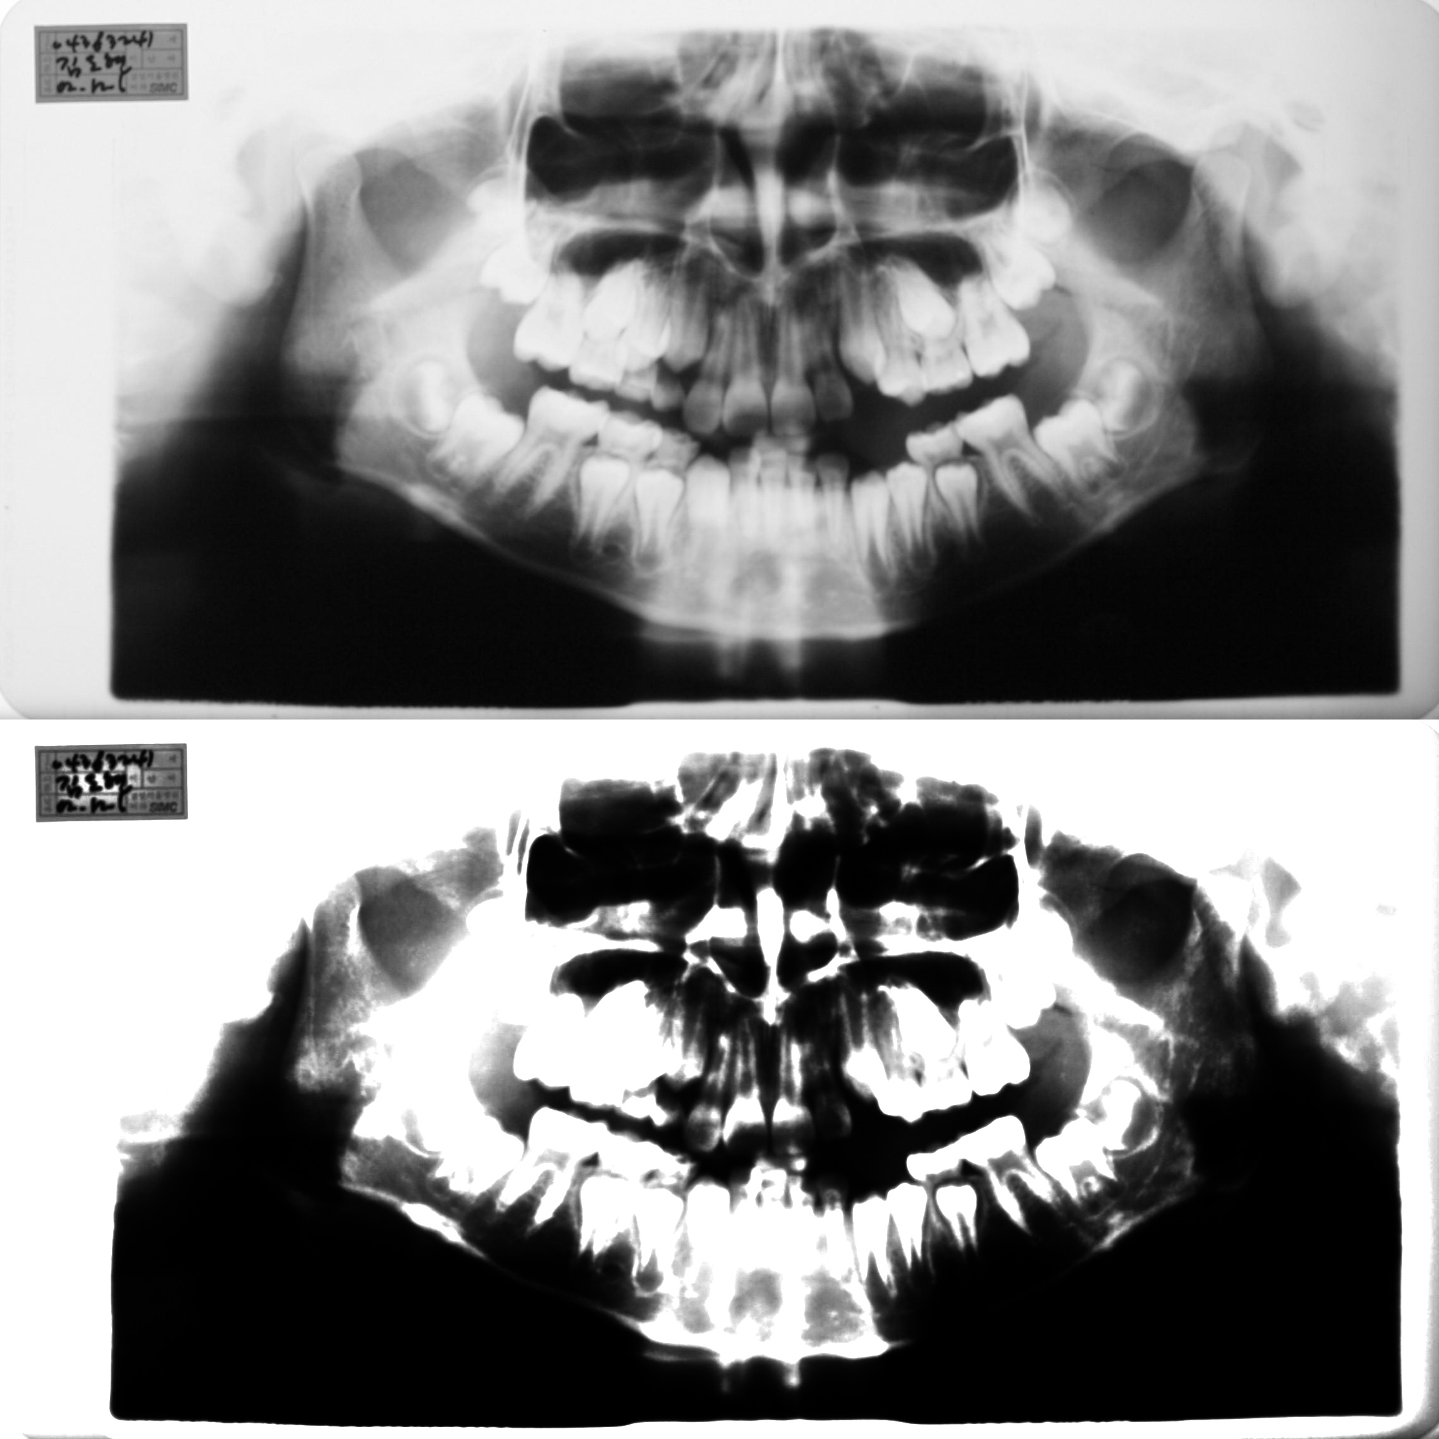
SOLUTION
PROBLEM
Fixing Alpha and Beta leads to over exposure and information loss in some images
Dynamic Alpha and Beta for each image
Information Loss

Slide 22
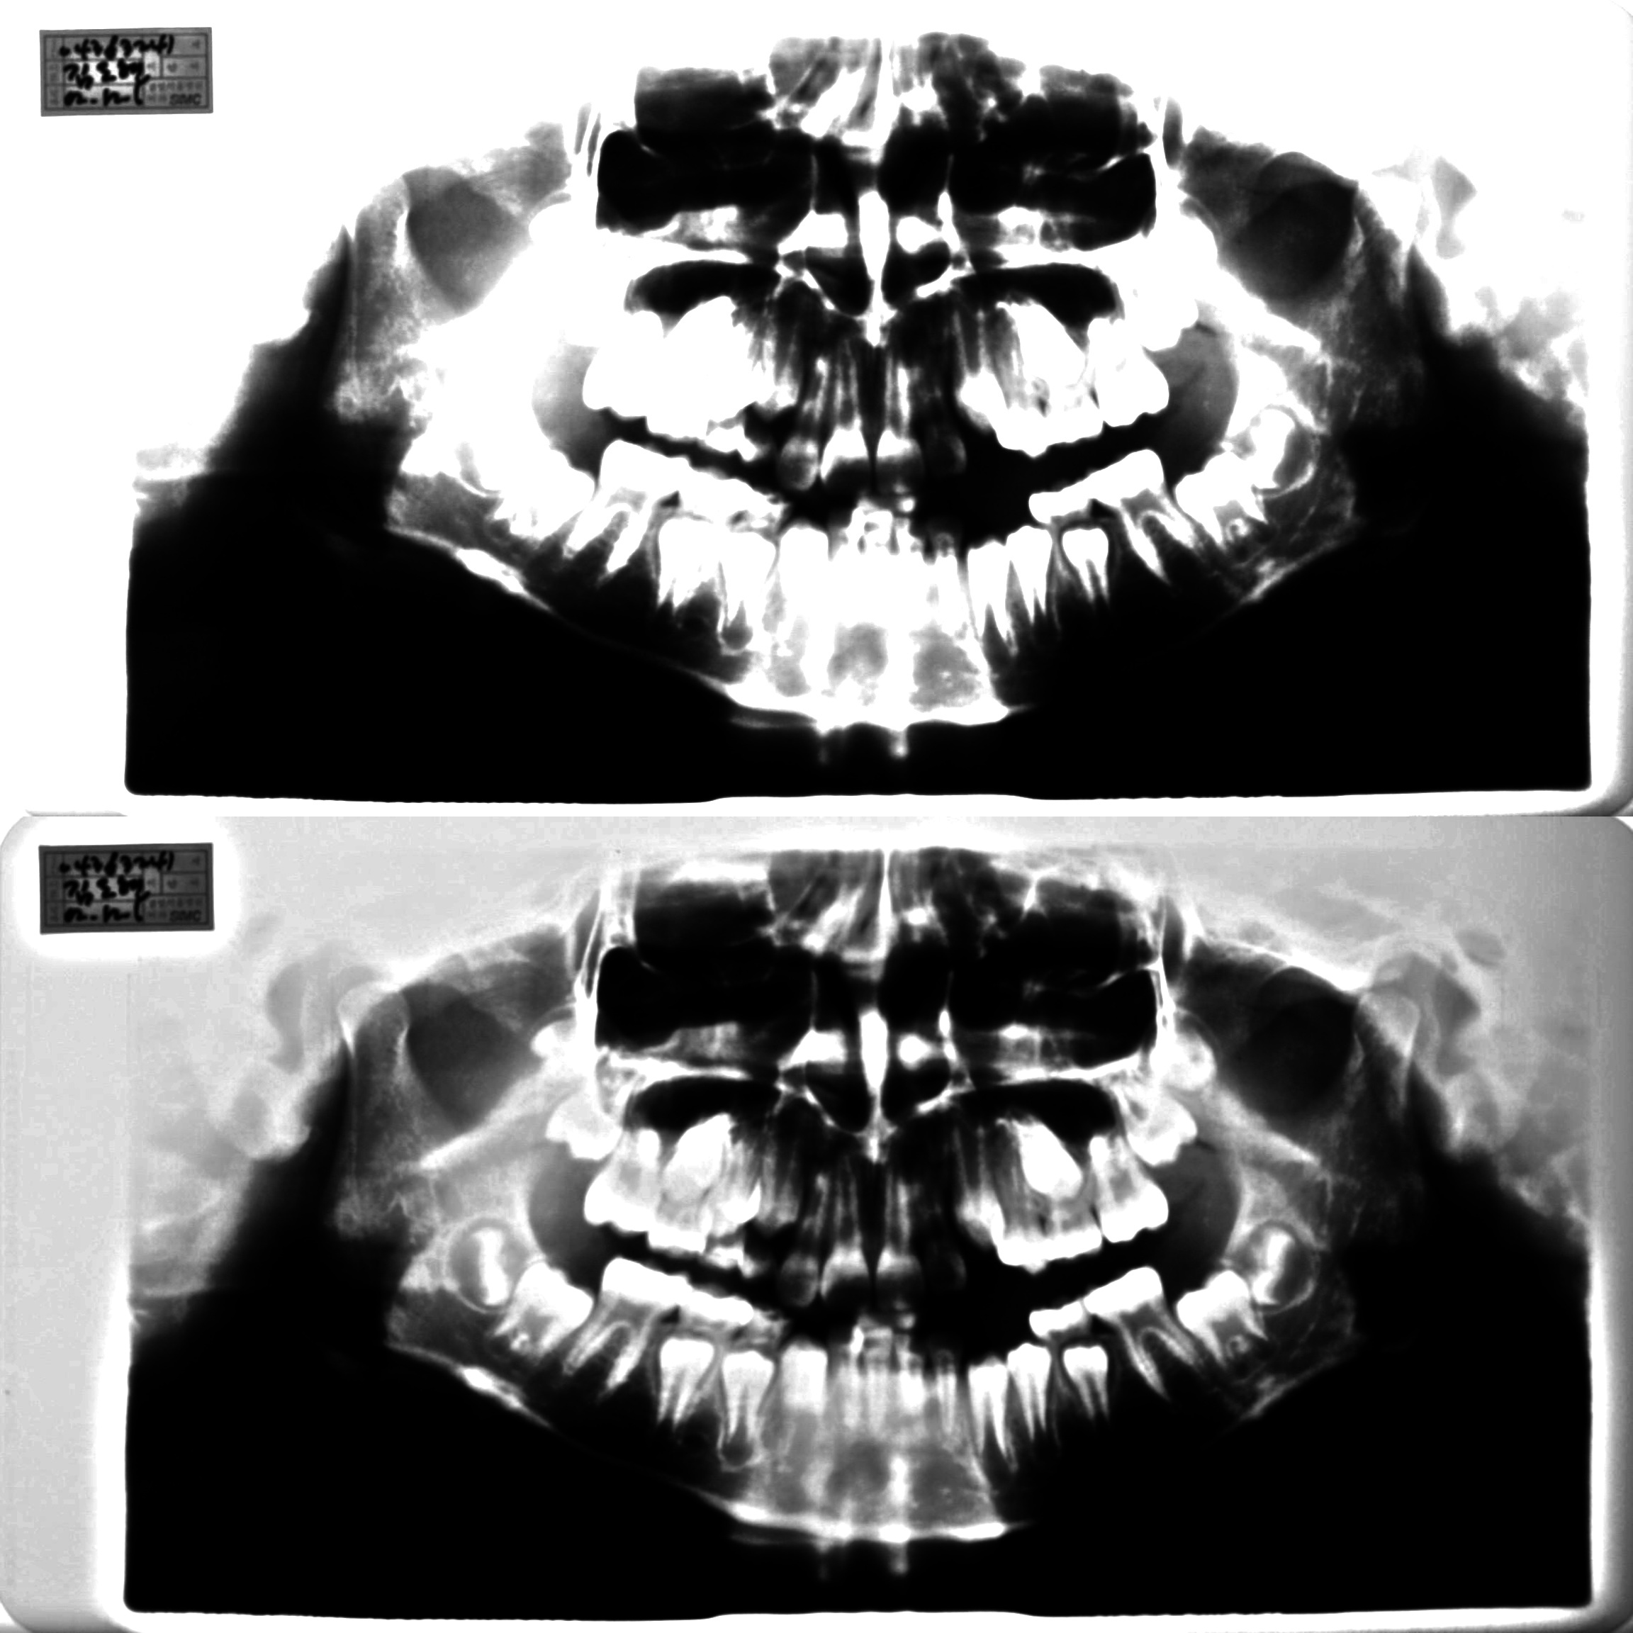
Fix Alpha & Beta
Dynamic
Alpha & Beta

Slide 23
AUTO CONTRAST
Alpha operates as color range amplifier, beta operates as range shift
O(x,y) = alpha * I(x,y) + beta
input range = max(I) - min(I)
wanted output range = 255;
alpha = output range / input range = 255 / ( max(I) - min(I) )
min(O) = alpha * min(I) + beta
beta = -min(I) * alpha

Slide 24
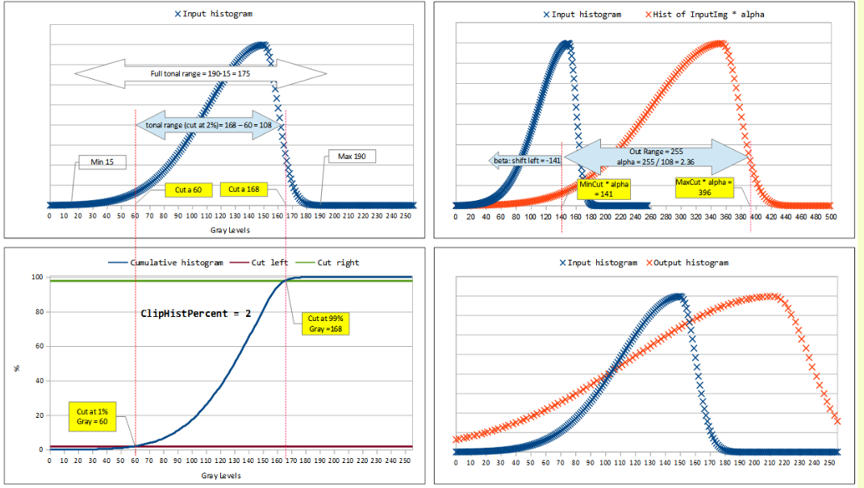

Slide 25
IMAGE SEGMENTATION
Enhanced Panoramic Dental X-ray
Partition of upper and lower jaw
Extraction of
ROI
Jaw Area Extraction

Slide 26
JAW AREA EXTRACTION
Enhanced
Image
Binary
Thresholding
Convert image to B/W grid
Find points around jaw
Fitting an ellipse

Slide 27
BINARY THRESHOLDING

Slide 28
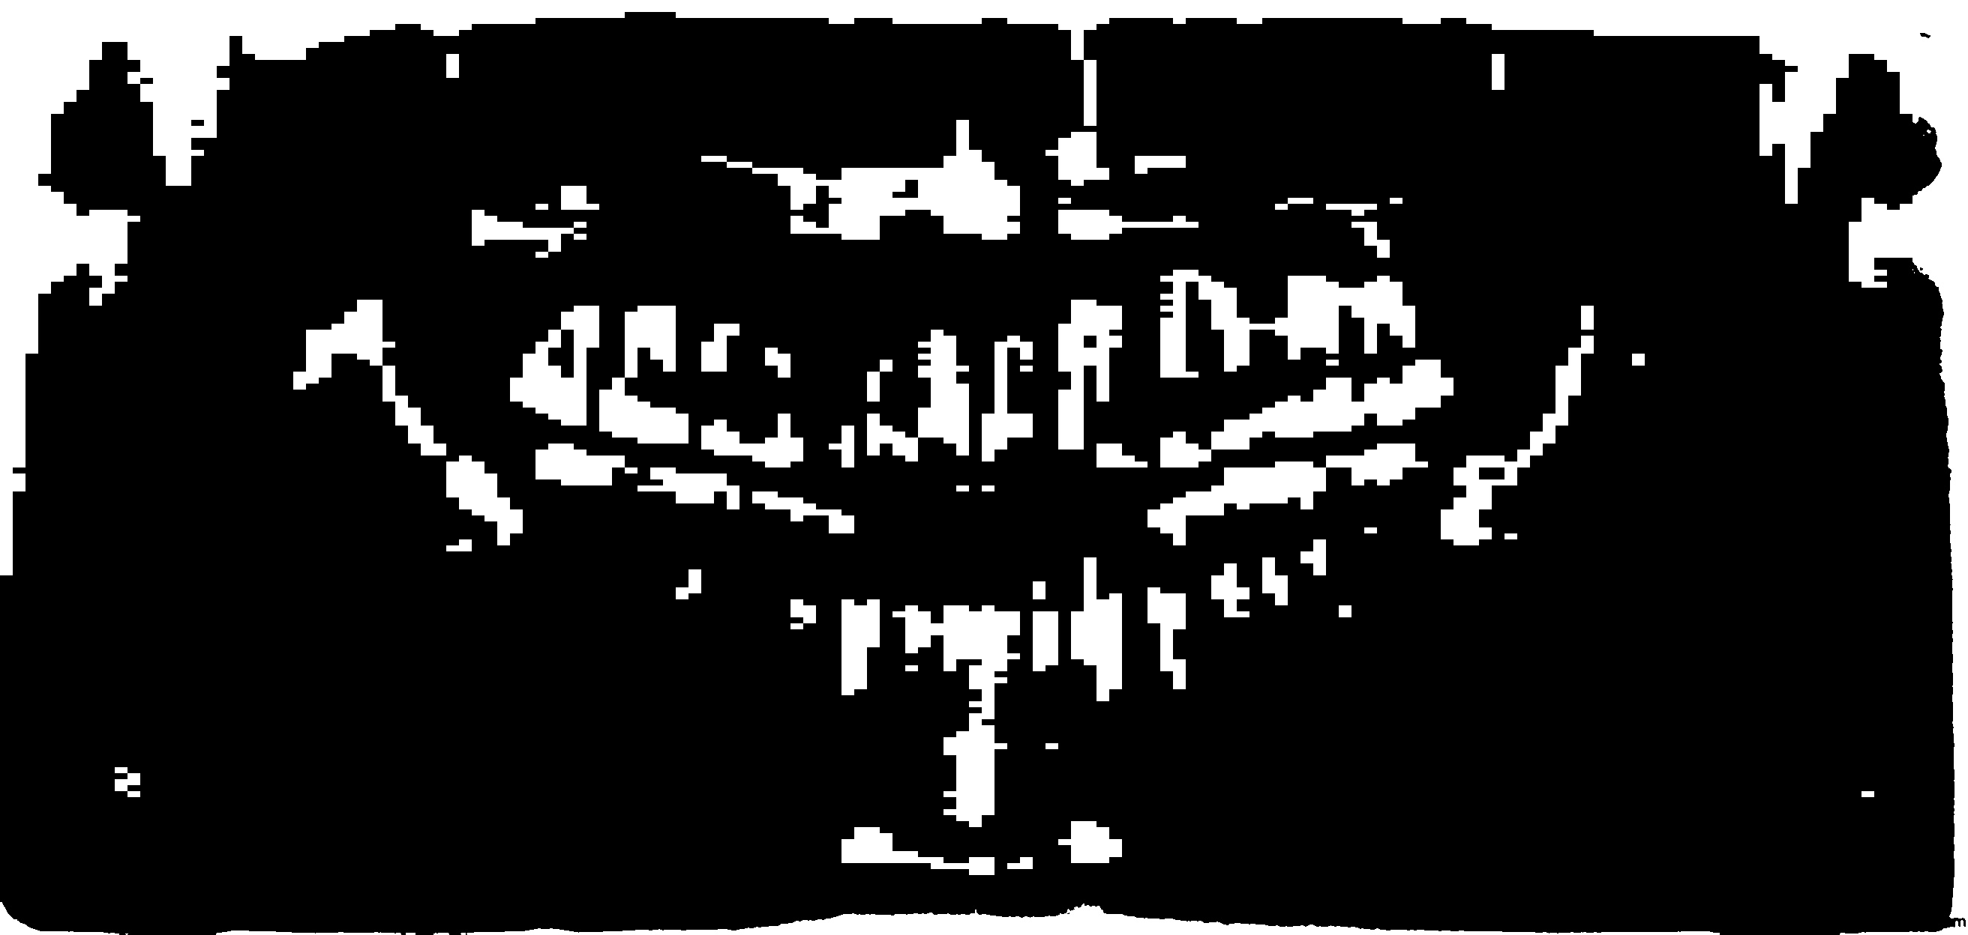
TRANSFORMING TO GRID

Slide 29
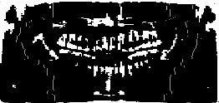
FINDING MIDPOINTS

Slide 31
RESULT: POINTS AROUND THE JAW

Slide 32
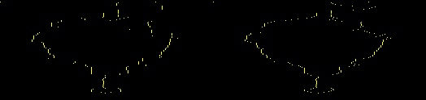
Before correction
After correction

Slide 33
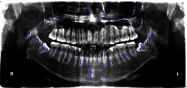
ELLIPSE FITTING

Slide 34
JAW AREA EXTRACTION

Slide 35
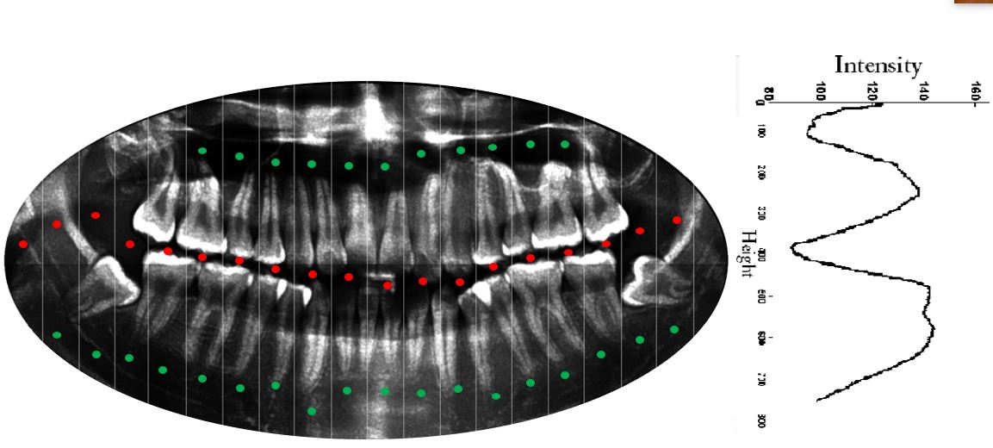
PARTITION OF UPPER & LOWER JAW
Column wise Summation

Slide 36
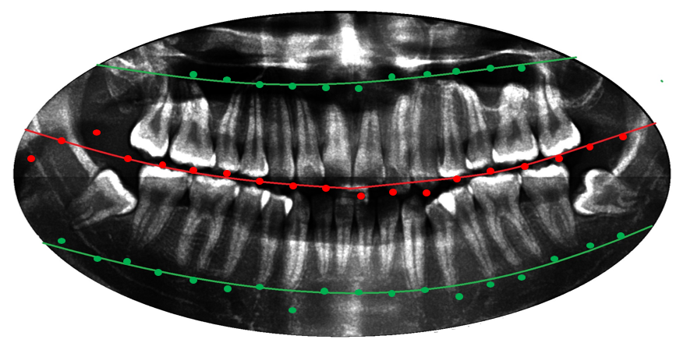
PARTITION OF UPPER & LOWER JAW
Curve Fitting

Slide 37
JAW SEPERATION

Slide 38
REMOVAL OF EXTRA PORTIONS
Upper Jaw
Lower Jaw

Slide 39
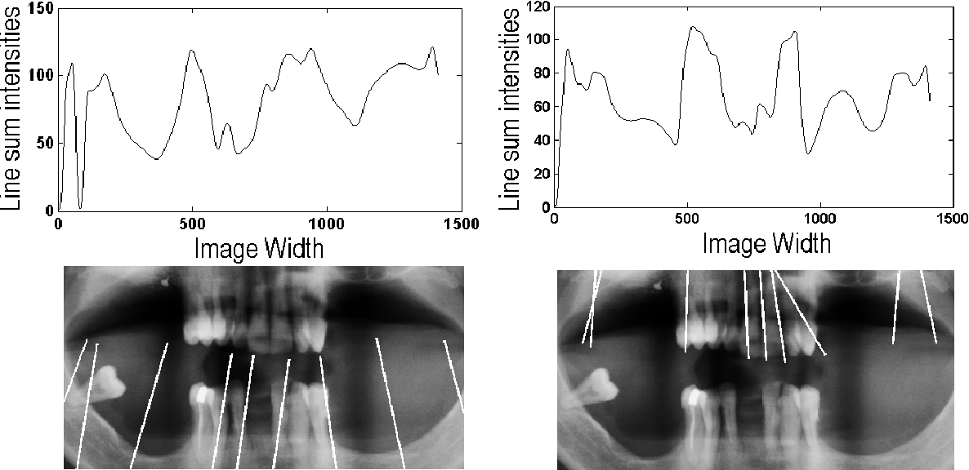
TEETH GAP VALLEY DETECTION
Upper Jaw
Lower Jaw

Slide 40
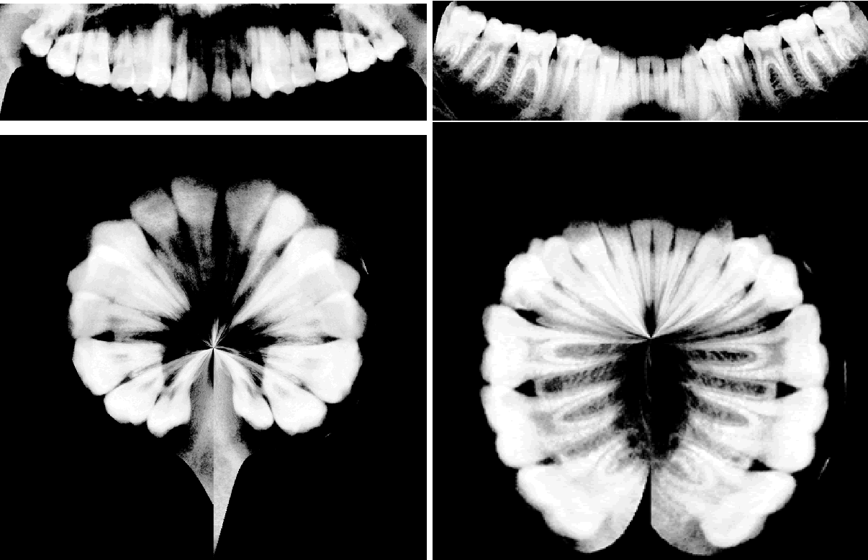
CHANGE COORDINATE SYSTEM
Cartesian Coordinates system
Lower Jaw
Upper Jaw
Polar Coordinates system

Slide 41
TEETH ISOLATION
Upper Jaw
Lower Jaw

Slide 42
ROI EXTRACTION
R1
R2
R3
R4

Slide 43
RESULT: ROI EXTRACTION
Stages | Result (in %) | Number of images
Jaw extraction | 95.7 | 273
Jaw partitioning | 92.6 | 273
Teeth gap valley detection | 87.5 | 273

Slide 44
DATASET LABELING
After ROI extraction, we get 4 sub images from each image in the original dataset
Total of 1092 sub images from original 273 images in the dataset
93 images were discarded due to very bad quality
999 images are labeled into 2 classes being diseased and healthy
Number of images in class ‘healthy’: 684
Number of images in class ‘diseased’: 315
Class imbalance removal: using random under sampling
369 x-ray images were eliminated from the ‘healthy’ class

Slide 45
TRANSFER LEARNING:NN CLASSIFIER
TL method in conjunction with the Xception network as pre-trained model on ImageNet weights.
Two last layers (logistic and pooling) were removed from the original model
A new Global Average Pooling layer (GAP) was inserted
Followed by a dropout layer with 0.5 of keeping rate.
A logistic layer of two neurons with Sigmoid activation was collocated at the end of the network to predict the probability of the classes.

Slide 46
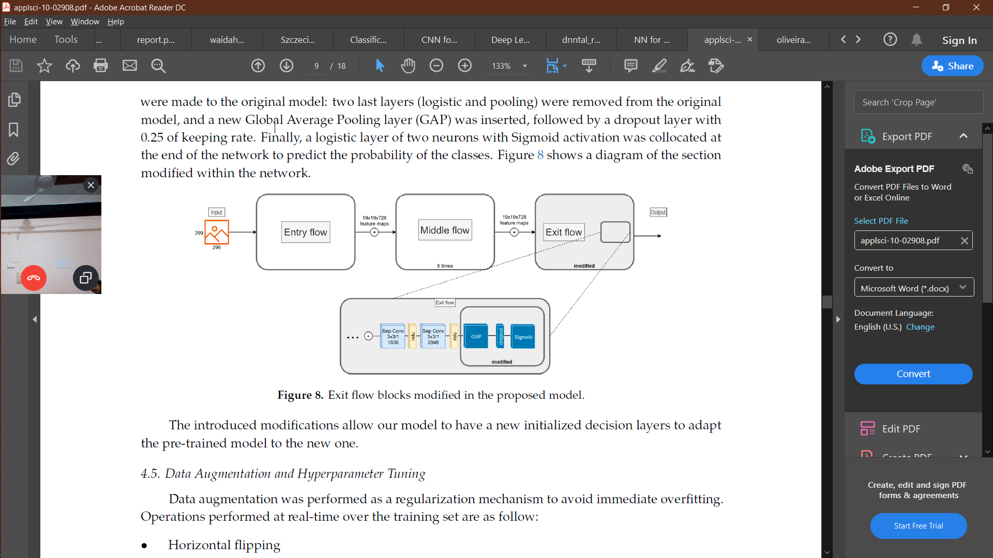

Slide 47
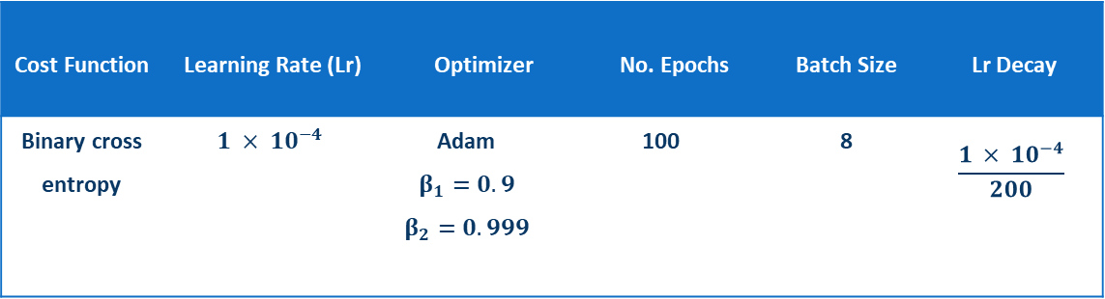
NETWORK HYPERPARAMETERS
Cost Function | Learning Rate (Lr) | Optimizer |  | No. Epochs | Batch Size | Lr Decay
Binary cross entropy | $$1 × {10}^{−4}$$ | Adam $$β_{1}=0.9$$ $$β_{2}=0.999$$ | 100 |  | 8 | $$\frac{1 × {10}^{−4}}{200}$$

Slide 48
EXPERIMENTAL SETUP
A partition was performed with an 75-25 hold-out as a validation method
35 images were in test set
The Xception CNN model used in this project and final neural network architecture was implemented in the Deep Learning framework Keras in Tensorflow
The pre-processing technique and ROI extraction were both implemented in Python 3.6 using OpenCV
All experiments were conducted in the Google Collaboratory platform

Slide 49
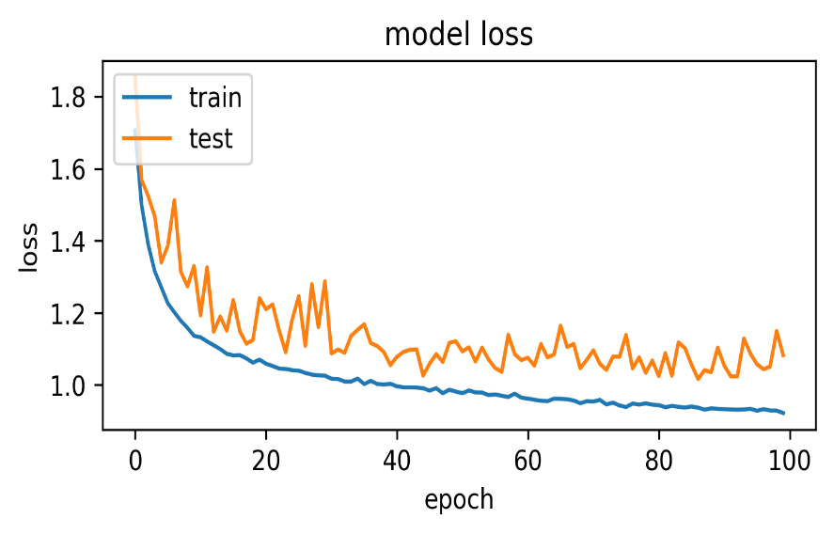
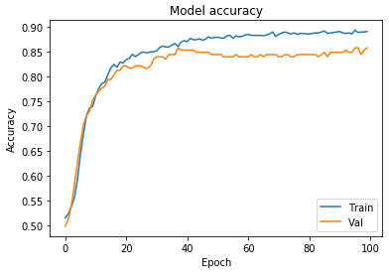
CLASSIFICATION RESULT
Best Epoch | Validation Loss | Average training time per epoch | Precision | Recall | F1-Score
29 | 0.0453 | 31s | 0.843 | 0.992 | 0.912

Slide 50
OBJECT DETECTION: DATASET
315 images of class ‘diseased’ will be used here as dataset
Additionally, 120 periapical x-ray images are also used in training of neural network to get better accuracy in object detection.
Class | Number of labels
PeriodontalDisease | 109
Caries | 80
ImpactedTooth | 57
Abscess | 31
Rootpiece | 30
NoDisease | 101

Slide 51
PREPROCESSING
Data augmentation was performed as a regularization mechanism to avoid immediate overfitting.
Operations performed at real-time over the training set are as follow:
Horizontal flipping
Zoom range of +10% to -10%
Random rotation of 0.1 degrees
After applying above augmentation techniques randomly, total of 864 images were prepared for the final dataset.

Slide 52
OBJECT DETECTION: FASTER RCNN
A partition was performed with an 75-25 hold-out as a validation method.
Test set contained 25 images.
Tensorflow using tensorflow object detection API, data augmentation was performed using keras datagenerator.
All experiments were conducted in the Google Collaboratory platform

Slide 53
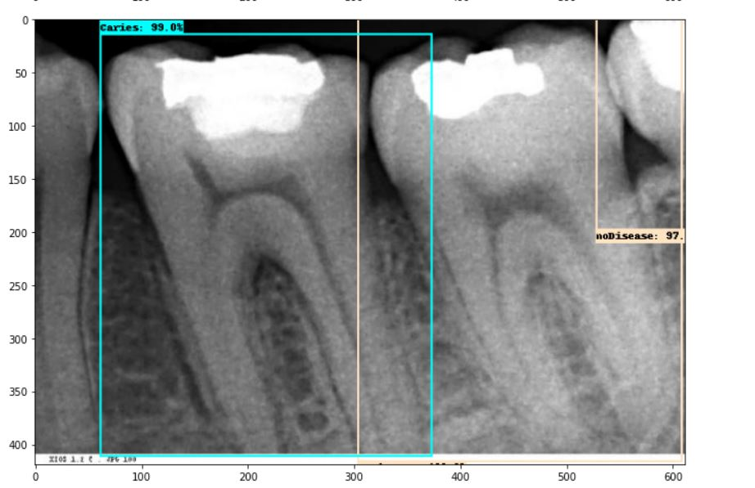
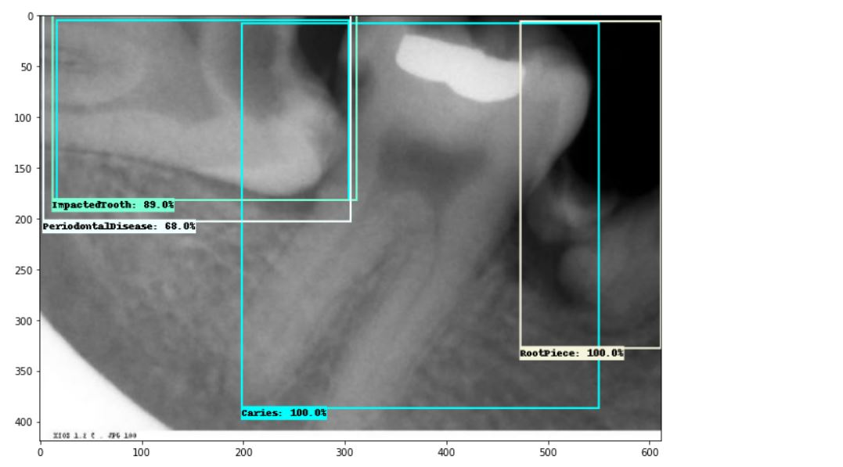
OBJECT DETECTION RESULT
The object detection model was trained for 30,000 epochs and the final loss is 0.045.

Slide 54
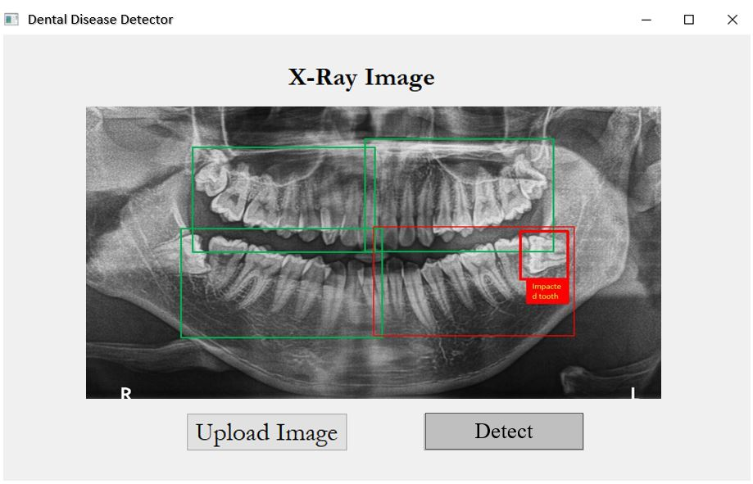
FINAL RESULT

